Slide 1
Parent Guidance
Children should already have experience of identifying verbs as well as identifying the simple past and present tenses.
This resource will focus on the correct and consistent use of forms of the past and present tense within a sentence.
Resources which build on this therapy, challenging pupils to identify and use the simple past, present and future tenses, are available (see Year 3 GPS resources).

Slide 2
Parent Guidance
Common misconceptions to be aware of:
Incorrect belief that words such as today, tomorrow etc. indicate the tense of a sentence. Reality: the verb shows the tense of a sentence, e.g. Past tense: Today, I visited my sister. Present progressive tense: Today, I am visiting my sister.
Incorrect belief that all sentences in the simple past tense contain a verb ending in the -ed suffix. Reality: regular verbs use the -ed suffix in their simple past tense form. However, many verbs have irregular past tense forms, e.g. I was, they had, we caught, she saw etc.
Incorrect assumption that every word that ends in -ed is a past tense verb. Reality: some words that end in -ed are not verbs, e.g. I am delighted. (‘Delighted’ is an adjective in this sentence; the verb is ‘am’ so this sentence is in the present tense.)

Slide 3
Vocabulary task
Put these words into pairs.
Explain the connections that you made.
name tense
describe noun
verb adjective

Slide 4
What is tense?
The mouse squeals.
The mouse squealed.
The mouse will squeal.
Which sentence shows the mouse is squealing now?
Which sentence shows the mouse has already squealed?
Which sentence shows the mouse will squeal in the future?

Slide 5
What is tense?
Tense tell us when something has happened, is happening or will happen.
Past
tense
Present tense
Future
tense
It has already happened.
It is happening now.
It will happen later.

Slide 6
What is tense?
The mouse squeals.
The mouse squealed.
The mouse will squeal.
Present tense
Past tense
Future tense

Slide 7
Past tense

Slide 8
Present tense

Slide 9
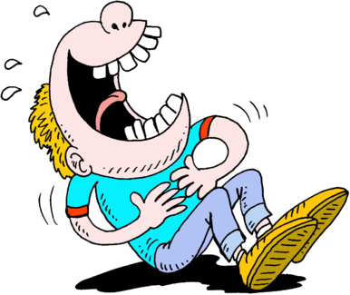
Tenses
Verbs show us which tense the writing is in. Notice how you can have different forms of each tense, depending on whether the action has finished or is still going on.
past present future
He laughed. He laughs. He will laugh.
He was laughing. He is laughing. He will be laughing.

Slide 10
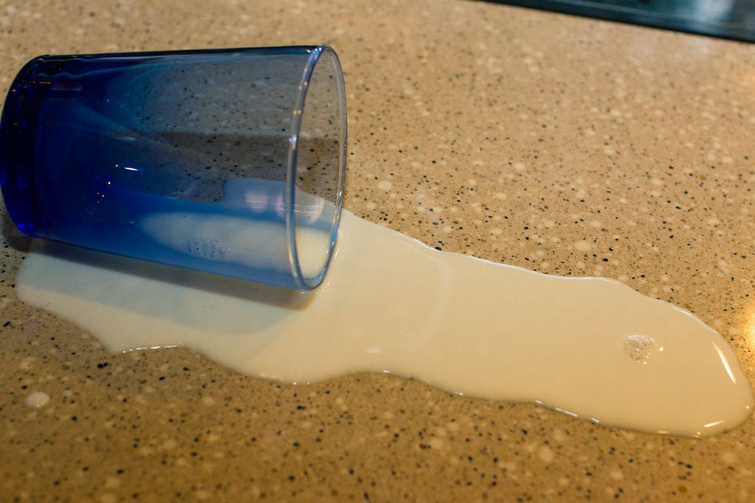
Your turn
Which sentence is in the present tense? Find the verb in each sentence to help you.
He wiped up the split milk.
He wipes up the split milk.

Slide 11
How did you do?
He wiped up the split milk .
He wipes up the split milk.

Slide 12
Past tense verbs
When writing in the past tense, you’ll usually need to add the suffix ‘ed’ to your verb.
BUT some verbs can be tricky! We call them irregular past tense verbs.
jumped
watched
washed
climbed
sleep – slept
go – went
eat – ate
speak – spoke

Slide 13
Present tense verbs
When writing in the present tense, you will usually find the verbs end in the suffixes ‘s’ or ‘ing’.
Karl smiles and walks away.
Mum is driving to me to school.
Len holds onto the branch before jumping off.

Slide 14
Using tenses correctly
It is important to keep your tenses consistent (the same) in your writing, according to its purpose. Otherwise, it can get confusing for the reader. For example, the verbs in these sentences are in the same tense.
Yazan found a bug and looked at it with a magnifying glass.
past tense
past tense
Sarah holds the worm carefully as she places it on a leaf.
present tense
present tense

Slide 15
Using tenses correctly
Look at what happens when the tense changes. It gets a little confusing for the reader.
Mr Cleaver passed the books to James as he explains the task.
past tense
present tense
Mr Cleaver passed the books to James as he explained the task.
past tense
past tense

Slide 16
Your turn
The sentence below should all be in the present tense. Circle one word that needs to be changed.
Karla walks into the classroom and picked up her lunchbox.

Slide 17
How did you do?
Karla walks into the classroom and picked up her lunchbox.

Slide 18
Choosing the correct tense
Different text types require different tenses.
Non-chronological reports require the present tense.
Narrative (stories) texts often require the past tense.
Instruction texts require the present tense.
Recount texts require the past tense.
Letter are mostly written in the present tense.

Slide 19
Sustaining the correct tense
Once you have decided which tense you need for the text type that you are writing, it is important that you sustain (keep up) the same tense.
The mummy dragon flew over the cave. She had lost her baby. She was frantic with worry. With a puff of fire, she roared out his name.
sustained past tense

Slide 20
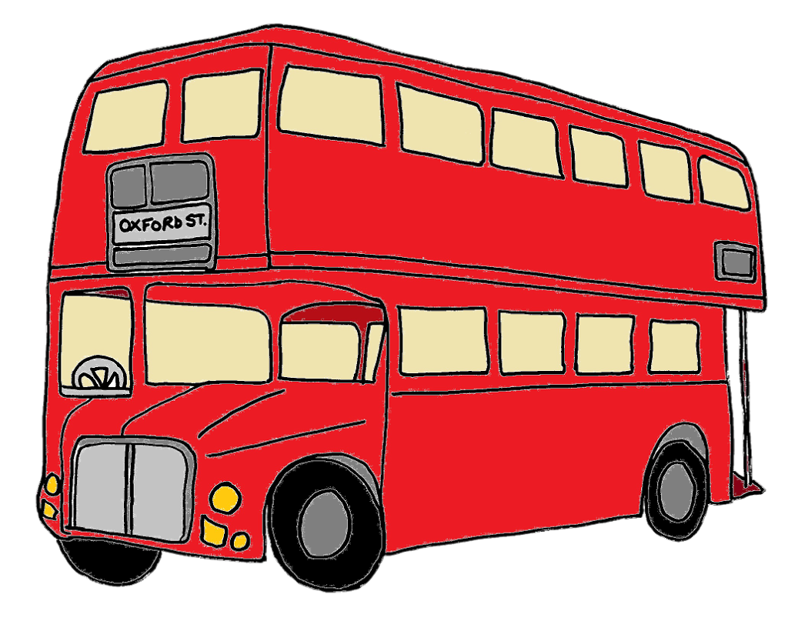
Your turn
Has the past tense been sustained in this extract? Explain your answer.
Henry ran for the bus, but he missed it. He was angry because now he was going to be late. He stomped down the road as he drags his bag behind him.

Slide 21
How did you do?
No, the past tense has not been sustained. The verb ‘drags’ is in the present tense and should be changed to ‘dragged’.
Henry ran for the bus, but he missed it. He was angry because now he was going to be late. He stomped down the road as he dragged his bag behind him.

Slide 22
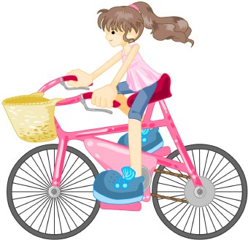
Your turn
Has the present tense been sustained in this letter extract? Explain your answer.
Dear Granny
I am writing to thank you for my new bike. I loved it. I am riding to school everyday. Daddy says I am a whizz on my bike!

Slide 23
How did you do?
No, the present tense has not been sustained. The verb ‘loved’ is in the past tense. It should be ‘love’.
Dear Granny
I am writing to thank you for my new bike. I love it. I am riding to school everyday. Daddy says I am a whizz on my bike!

Slide 24
Writing challenge
Continue this story, making sure you sustain the past tense.
It started like any other day. I got up and went to the barn. I let out the animals and collected the feed. I was cleaning out my horse’s stall when I heard an almighty bang!

Slide 25
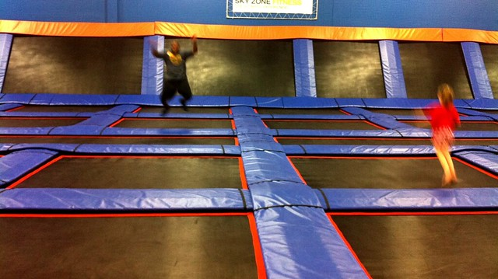
Writing challenge
Continue this letter of complaint in the present tense.
23 November 2020
Dear Manager
I am writing to complain about your trampoline park. Your trampolines are dirty and worn. The staff are unfriendly and at times rude.

Slide 26
Remember
Tenses tell us when things are happening: past, present or future.
The tense of the writing is shown by the verbs.
Different text types require different tenses.
Sustain the appropriate tense throughout your writing.

