Slide 1
COMPUTING
28/01/21

Slide 2
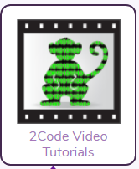
2Code
Using Purple Mash 2Code Chimp, Gibbon or Gorilla see if you can add more detail to your existing game
Have a go at watching the Video Tutorials to help you with your coding skills
Save your work and send it in to me!

