Slide 1
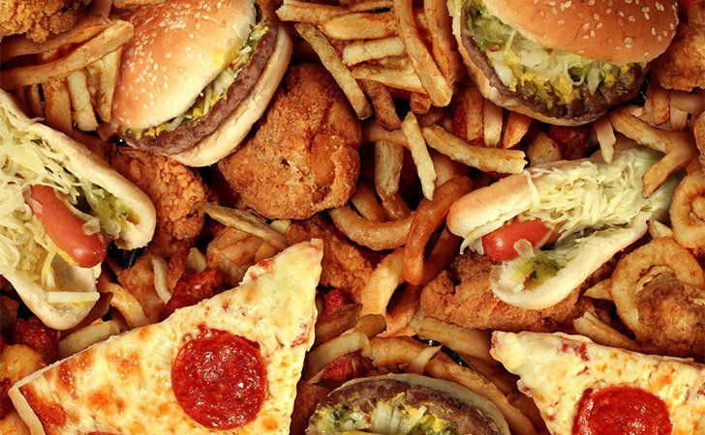

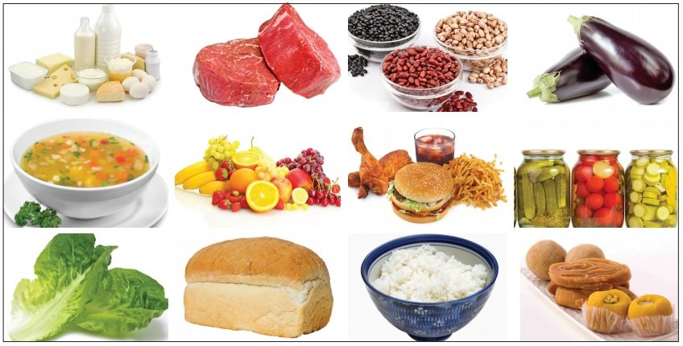
Thursday 28th January 2021
Design and technology

Slide 2
Over the last couple of weeks, we have ben looking at healthy eating and a varied diet, we have been discussing where food comes and will begin to think about preparing our own tasty and healthy meal.

Slide 3
Please watch the clip underneath
https://www.youtube.com/watch?v=8VZaUUTy_tM&safe=active

Slide 4
Can you remember the names of all the five food groups?
This week we will be designing a tasty healthy meal that you will be able to cook in next Wednesday’s Design and technology lesson!!
BUT
There is a challenge we would like you to combine two food groups in your chosen dish!
On the next slide there are some ideas and recipes!

Slide 5
You could prepare a tasty sandwich, all of the sandwiches below have two ingredients from two food groups.
Ham and cheese
Tuna and cucumber
Cheese and tomato
Cheese and onion

Slide 6
You could prepare a tasty soup!
Noodle and vegetable
Chicken and vegetable

Slide 7
You could prepare a pasta dish!
Tuna and sweetcorn
Cheese and tomato

Slide 8
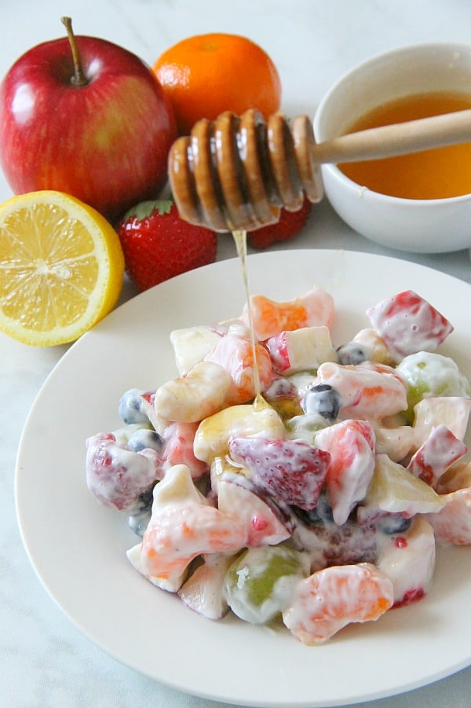
You could prepare a fruit salad with yoghurt!

Slide 9
Task 1
Could you choose one of the dishes or think of one of your own?
You must write down the ingredients you will need.
Task 2
Could you and an adult write down the instructions to prepare your dish.
There is an example on the next slide.

Slide 10
Noodle and vegetable soup
You will need:
Vegetable or chicken stock.
Olive oil
Noodles
1 X clove of garlic
1 X onion
Salt & pepper
Potatoes
Vegetables – you could use; carrots, celery, broccoli or any vegetables you will like.
Fresh parsley (optional)
Carefully with adult supervision chop your vegetables.
Heat the olive oil in a medium saucepan over medium heat.
Add all the vegetables, garlic and onion.
Season with a pinch of salt and pepper, and cook for around 3minutes.
Carefully add 2 cups of boiling water and your stock.
Add the noodles and cook on medium to low heat for 10-15 minutes.
Wait for your soup to cool down and enjoy.
TIP: This soup freezes well, so freeze any leftovers or make a double batch to have plenty on hand. You can also stir in some cooked chicken or mini-meatballs, if desired, for another meal.

Slide 11
Can you send a picture of your writing to us?
lara.crawford@worthvalleyprimary.co.uk
steph.milner@worthvalleyprimary.co.uk

