Slide 1
English Tuesday 26.01.21

Slide 2
Handwriting Practice harder words – LETTERJOIN – Students – Password lj8943 (finger swipe is in the shape of a letter L) https://www.letterjoin.co.uk/tablet_login/

Slide 3

Reading
Tuesday’s reading task is a picture comprehension. All children can complete this reading activity. I have uploaded it to Purple mash under the 2do section.
The work is on a word document so type answers on to it and send it back via Purple mash.
Any problems please email me,
r.metcalf@worthvalleyprimary.co.uk

Slide 4
Spellings This weeks spellings are: harass, forty, foreign, government, interrupt, signature, sincere, soldier, stomach, sufficient.
Group 1

Slide 5
Spellings This weeks spellings are: house, friend, pull, clothes, busy, people, grass and class.
Group 2

Slide 6
click on the 2 do section on purple mash to find the spelling activity https://www.purplemash.com/login/
Today for spellings both groups are going to read the sentences and fill in the missing word using one of your spelling words from this weeks list.
Group 1 – ‘Tuesday Spelling group 1’
Group 2 – ‘Tuesday Spelling group 2’

Slide 7
Grammar Following on from yesterdays lesson you are going to use your fronted adverbials in sentences. For example: As fast as she could, she raced upstairs to put her socks on. This morning, she took her dog for a walk. Exhausted, the little, old lady crossed the road. Log into Purplemash, you will find 2write in the 2do section. https://www.purplemash.com/login/

Slide 8
Group 1 – You are expected to write 8 sentences. Every sentence must have a fronted adverbials in.
Group 2 – you are expected to write 6 sentences. Every sentences needs a fronted adverbial – if you get stuck thinking of them use the word mat on slide 7.
Group 3 – write 4 sentences using fronted adverbials. Use the word mat to help you on page 7.
DON’T FORGET TO USE A COMMA!
Later that day, Happily,

Slide 9
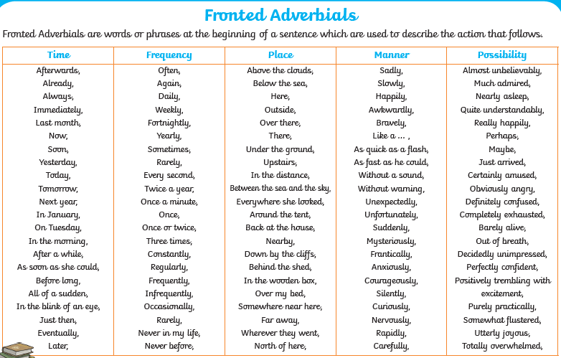

Slide 10
Writing task: Today you are going use your plan from yesterday and write your diary entry. Remember to use paragraphs, full stops, capital letters and look on the next slide for the features of a diary. It must be written in first person using I and needs to be written in the past (last week, yesterday). I have set 2write as a 2do so you can type your diary entry. I will also set a word document as well. Choose which you prefer. At the end please save/upload your work so I can mark it before Wednesday’s lesson as you’ll need to edit it in Wednesday’s lesson.

Slide 11


