Slide 1
English
Wednesday
27.01.21

Slide 2
Handwriting
Practice harder words – LETTERJOIN – Students – Password lj8943 (finger swipe is in the shape of a letter L) https://www.letterjoin.co.uk/tablet_login/

Slide 3
Reading
Reading today is set out in groups, if your unsure which group your child is in please email me.
The reading comprehension is on purple mash under the 2do section.
The work is on a word document so please type answers on to it and send it back via Purple mash.
https://www.purplemash.com/login/
Any problems please email me,
r.metcalf@worthvalleyprimary.co.uk

Slide 4
Spellings

Slide 5

Group 1
Using the following words and write a sentence for each word on 2write on Purplemash. Once you have finished save your work and it will automatically upload it back to me.
soldier signature sincere interrupt
government harass forty foreign
stomach sufficient

Slide 6
Spellings – group 2
This week you are going to focus on these words:
house friend pull clothes busy people
grass class
Write a sentence for each word using 2write on Purplemash

Slide 7
Writing task:
This lesson follows yesterday’s. All the work handed in from yesterday has been marked and some feedback has been given.
Today you need to read your diary entry with an adult at home and try improve the following areas:
Spellings
Tense – make sure you have written in the past tense.
Sense – does my work make sense?
Punctuation – have you used full stops, capital letters and finger spaces?
Have you included the features – date, dear diary, paragraphs, past tense, using ‘I’, is it interesting, does it include your feelings?

Slide 8
When editing your work please use a different colour like we do in class so I can identify what you have changed.
If you used the word document you should be able to open the copy you saved yesterday.
If you used 2write you should have it sent back so you can edit it.

Slide 9
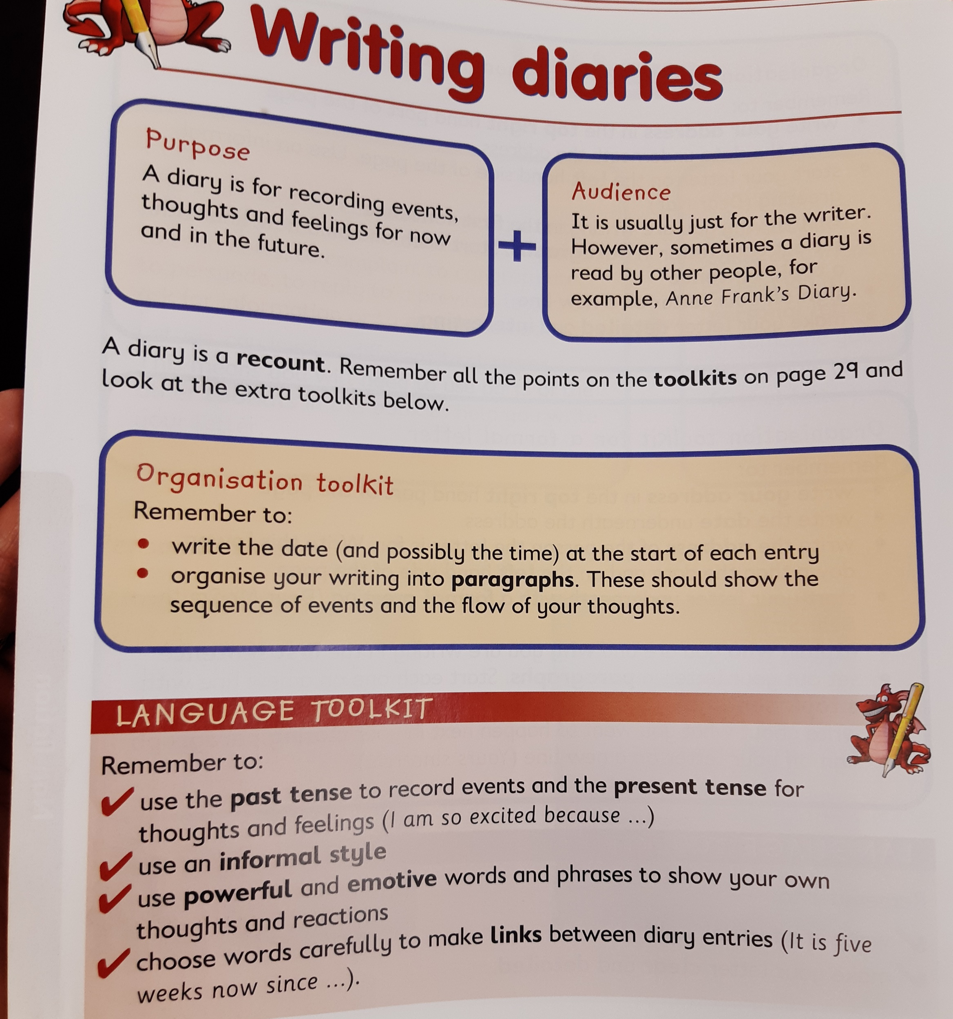
Features of a diary

