Slide 1
English
Thursday 28th January 2021

Slide 2
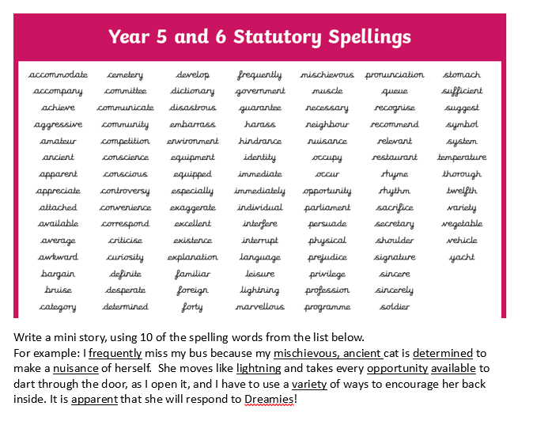

Slide 3
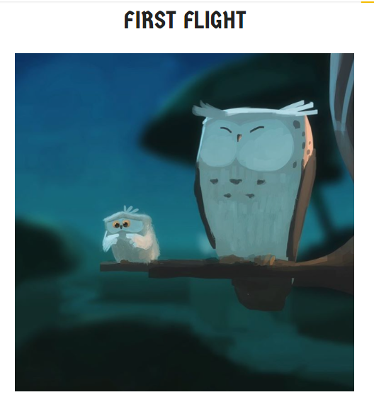
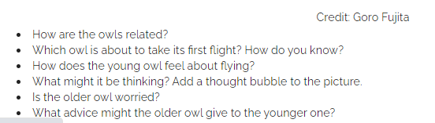
Answer the inference questions on Purple Mash

Slide 4


Reading Together for Pleasure
Miss Lodge, kindly bought us this lovely book ‘The Book of Hope’ just before the Christmas holiday. We thought it would be nice to share everyday ,some of the words and pictures to provide you with a little bit of comfort, inspiration and entertainment!
Hope you enjoy hearing our voices.

Slide 5
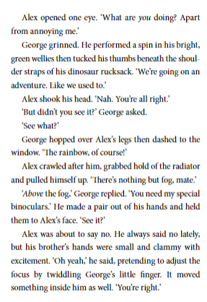
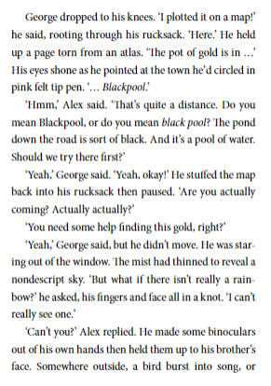
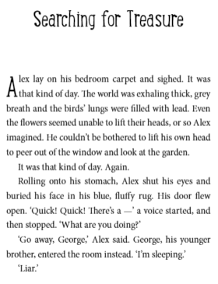
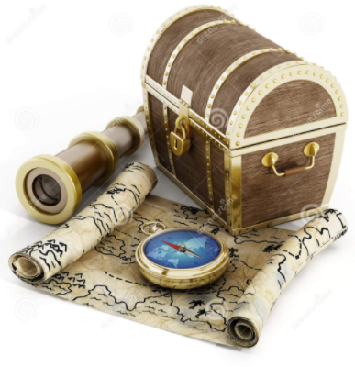


Annabel Pitcher

