Slide 1
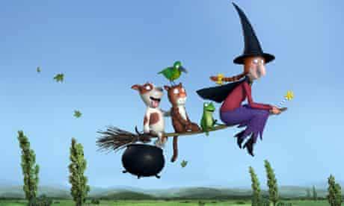
Friday 22nd January 2021
English tasks.

Slide 2
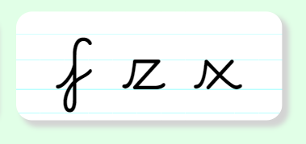
Handwriting
Please practise the letters:
Look on the letterjoin website to see how to form them correctly.
https://letterjoin.co.uk
Username: lj8943
If you are using a laptop the password is: home
If using an ipad or tablet the password is: capital L (Make the shape of a capital L)

Slide 3
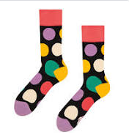
Can you knock my socks off with your neat writing?
Now that you have practised your letters on letter join can you practise on a piece of paper?
Can you send a picture of your writing to me?
s.hiley@worthvalleyprimary.co.uk

Slide 4
Reading and writing tasks
This week we are reading
Room on the Broom
by Julia Donaldson.
Here is the link to the story again if you would like to watch it again to help with your work for today.
https://www.bbc.co.uk/iplayer/episode/p0102qfj/room-on-the-broom

Slide 5
Reading Tasks (Our Whole Class Reading Session)
Can you put the story in the correct order?

Slide 6
Can you answer these questions?
How did the witch lose her hat?
What animal found the witches hat?
As the storm started, what object did the witch drop?
Do you think the witch preferred being on her own or having the animals with her? Can you explain why?

Slide 7
Writing Task
Can you design a new friend for the witch to join her on her broomstick?
It could be another animal, a witch or a boy or girl.
Who might you pick? Can you describe them and say why you think they would be a good friend for the witch?

Slide 8
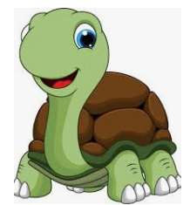
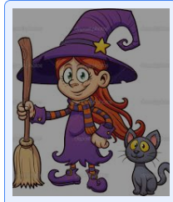
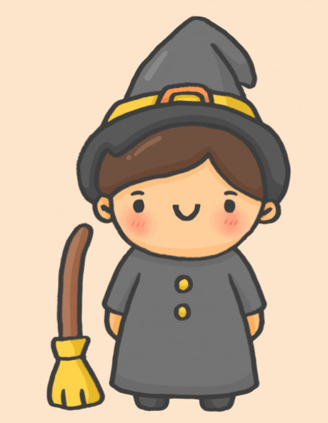
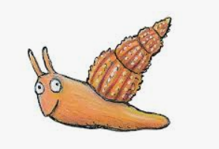
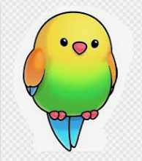
Here are some ideas of characters you might pick:
Don’t forget your neatest handwriting, finger spaces, capital letters and full stops.

Slide 9
Here is an example
;
Sammy the spider has eight long, black legs and a friendly face. I think she would be a good friend to the witch because she is kind and helpful. She is an expert at spinning beautiful webs so she would make the witch’s house look wonderful. She loves to sing so would be able to sing songs to help make the other animals happy.

Slide 10
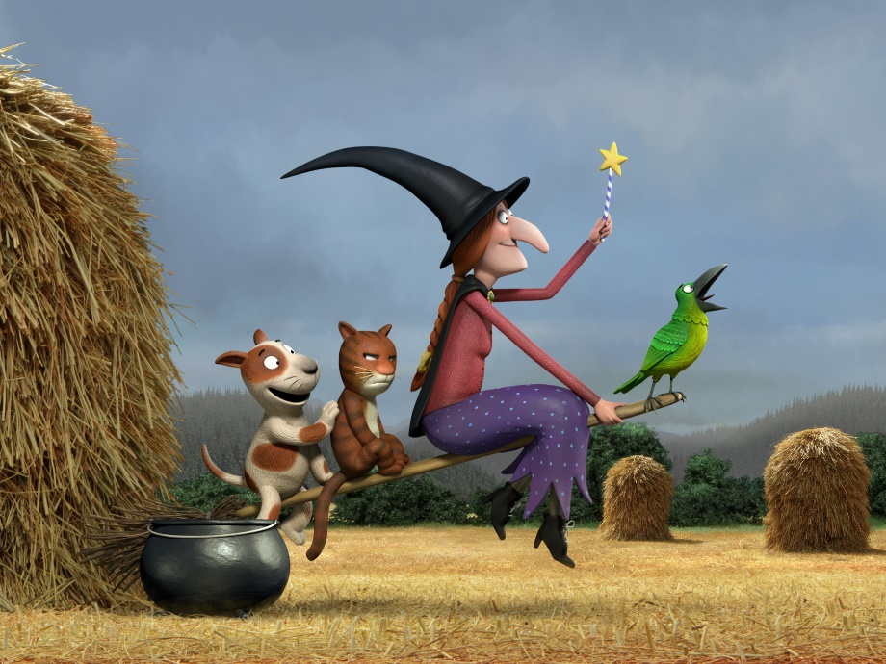
Remember I love to see your work so please email pictures to me at:
s.hiley@worthvalleyprimary.co.uk

