Slide 1
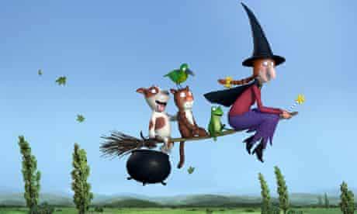
Monday 18th January 2021
English tasks.

Slide 2
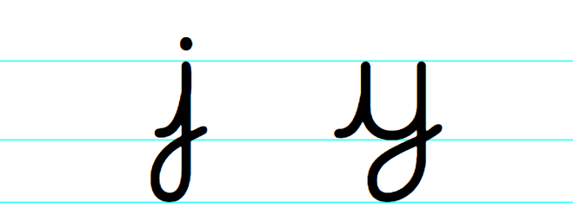
Handwriting
Please practise the letters:
Look on the letterjoin website to see how to form them correctly.
https://letterjoin.co.uk
Username: lj8943
If you are using a laptop the password is: home
If using an ipad or tablet the password is: capital L (Make the shape of a capital L)

Slide 3
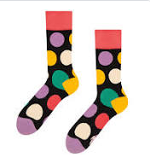
Can you knock my socks off with your neat writing?
Now that you have practised your letters on letterjoin can you practise on a piece of paper?
Can you send a picture of your writing to me?
s.hiley@worthvalleyprimary.co.uk

Slide 4
Reading Task
Good readers need to be able to use detective skills to make predictions. Can you make predictions about this book just from looking at the front cover? This can be written down or discussed with someone at home.
Remember we use sentence starters such as :
I predict…..
I wonder if……
I think that……….because……..

Slide 5
Reading Task
This week we are reading
Room on the Broom
by Julia Donaldson.
Can you watch the film using the link below?
https://www.bbc.co.uk/iplayer/episode/p0102qfj/room-on-the-broom

Slide 6
Writing Task
Now that you have listened to the story can you tell me about what you thought of it.
What was your favourite part of the story can you draw and label your favourite part?
Were there any parts of the story you did not like?
Don’t forget your neatest handwriting, finger spaces, capital letters and full stops.

Slide 7
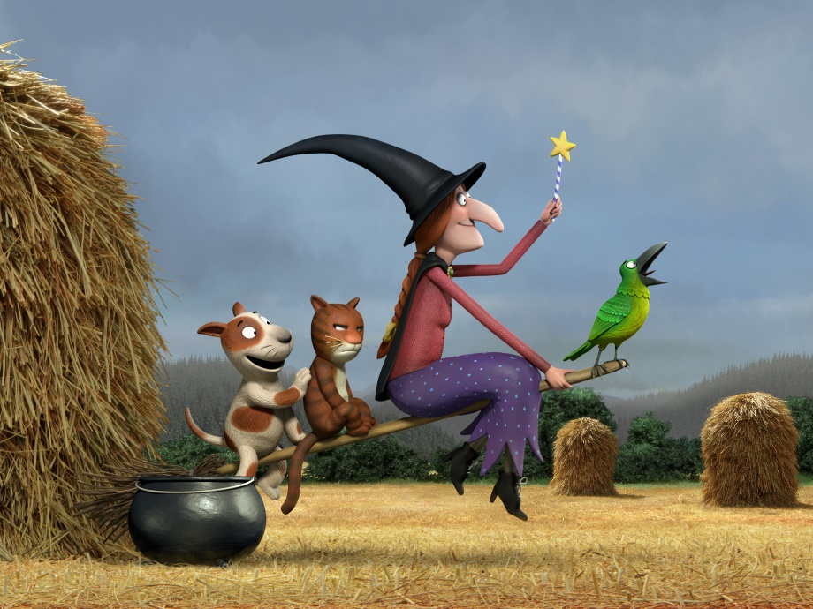
Remember I love to see your work so please email pictures to me at:
s.hiley@worthvalleyprimary.co.uk

