Slide 1
English
29/01/2021

Slide 2
Reading Activity
Please see the next slides for your group`s activity
Let me know if you can`t remember which Reading group you are in
You will need a pencil or pen, and paper

Slide 3
Groups 1 and 2
2Do Purple Mash task
The Kite – read through and answer Set B questions

Slide 4
Groups 3 and 4
2Do Purple Mash task
My Best Friend – read through the text again
Then answer Set B questions

Slide 5
Handwriting + Spellings Group 3
Suffixes ending in –sion and -tion
The suffix with the /shun/ sound can be spelled in two ways: -sion and -tion.
Root words ending in ‘t’ or ‘te’ lose these final letters and have the suffix -tion added. Root
words ending in ‘de’, ‘d’ or ‘se’ lose these final letters and have the suffix -sion added.

Slide 6
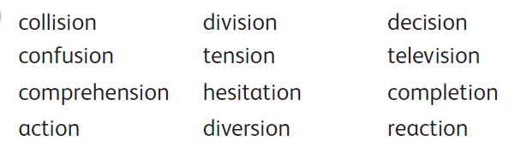
Group 3 Handwriting and Spelling list

Slide 7
Spelling group 3
Then have a go at Phase 5 and 6 games on
https://www.phonicsplay.co.uk/resources
Or practise, play games and test yourself on Spelling Frame https://spellingframe.co.uk/spelling-rule/17/13-Endings-which-sound-like--spelt%E2%80%93tion%E2%80%93sion%E2%80%93ssion%E2%80%93cian-(1-of-2)

Slide 8
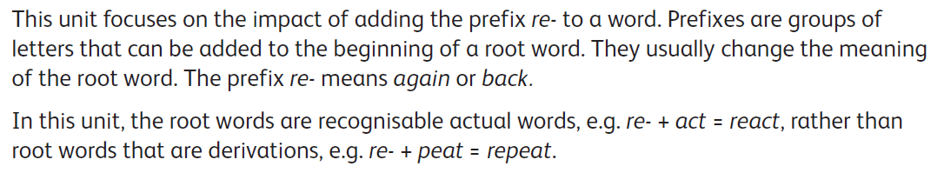
Handwriting and Spellings Group 2

Slide 9
Handwriting + Spellings Group 2

Slide 10
Group 2 Spellings
Then have a play around with the different games and tests on
https://spellingframe.co.uk/
And
https://www.phonicsplay.co.uk/resources

Slide 11
Handwriting + Spellings Group 1
This week we are looking at words with the letter or sound `g` in them
These words could begin with g or j, or contain g in the middle
Some of these words have a different sounding `g` to others – can you spot these?
sledge jet orange bridge jar badge
giant hedge joke magic huge glove

Slide 12
Handwriting + Spellings Group 1
Try the Spelling Frame practise, games and tests on https://spellingframe.co.uk/spelling-rule/78/1-The-sound-spelt-as-ge-and-dge-at-the-end-of-words
Or the Phonics Play website https://www.phonicsplay.co.uk/resources

Slide 13
Handwriting
Use the spelling sheets to practise your handwriting. You will not be able to trace the word, unless you can print the sheets off, but you will be able to copy it.
Practise 3 words per day on lined paper and then have a go at writing sentences with those words in
Remember, it is quality joined writing that we are looking for, with your proper tripod grip
You can also practise other letters and words via https://www.letterjoin.co.uk using the username lj8493 and the password L (capital l)

Slide 14
Grammar
This week we are looking at joining sentences
We join different ideas in one sentence by using conjunctions
This week we are focusing on co-ordinating conjunctions
We can remember these through the acronym FANBOYS
For And Nor But Or Yet So

Slide 15
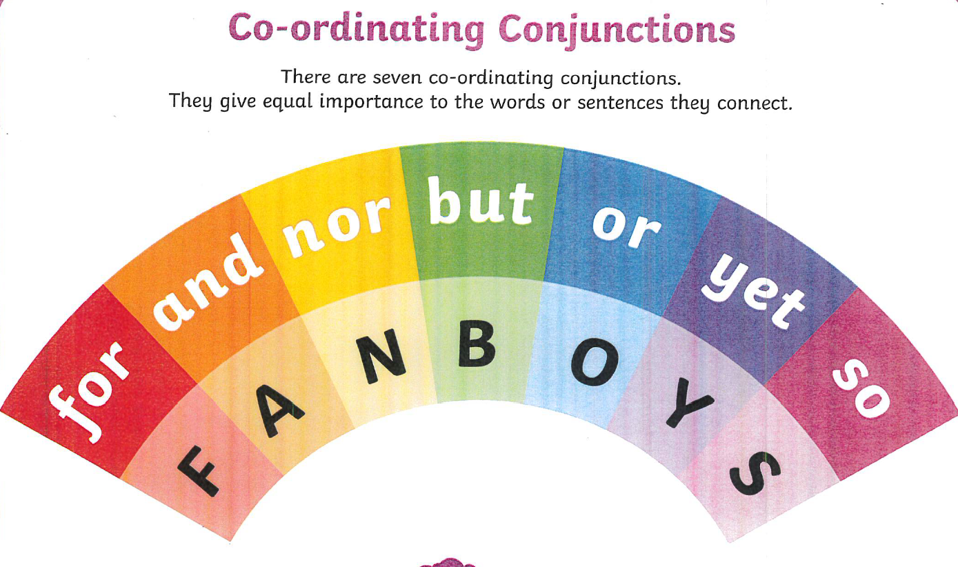

Slide 16
Grammar
Can you improve the text below by adding your own punctuation and conjunctions. Hint – you may also need capital letters.
I woke up and rushed downstairs and then I saw it standing there it was amazing and I said to my Mum thanks how did you get that in here and after that I went to school and we had P.E and then it was lunch and I went to the toilet and I felt sick it was horrible uurgh and then I went home and had tea and I was tired and I went to bed what a day

Slide 17
Newspaper reports
Yesterday we had a go at converting Street Child into a newspaper report, focusing on the headings and powerful vocabulary
Today we will read Chapter 15. See 2Do Purple Mash tasks Chapter 15a and 15b.
Then let`s have another go at planning a newspaper report.
Create your own main heading and 3 or 4 sub-headings, along with powerful vocabulary for each section.
Use a pen and paper to write down your ideas and maybe you could send them through to us?

