Slide 1
English
Friday 29th January 2021

Slide 2
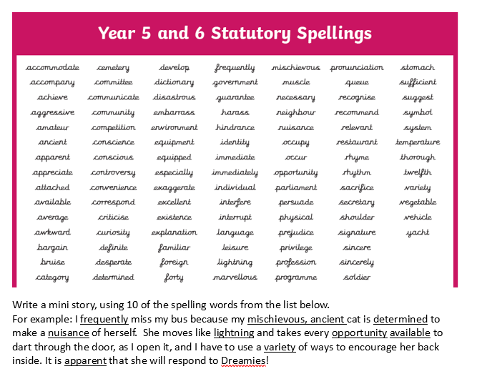

Slide 3
Can I use ellipsis in my writing?
An ellipsis can be used for different purposes and can be very useful in your writing.
It can be used to show a word or words that have been removed from a sentence or quote.
Example: ‘The space station has a cracked window… dangerous.’ Here, ‘this is very dangerous’ has been removed and replaced by an ellipsis and only the word 'dangerous'.
When a character finishes a sentence in their head, or their thought trails off.
Example: If your grown-ups ask you if you have tidied your room, you might reply, “Well I was going to…”. Here, the ellipsis has finished the sentence and replaced “but I haven’t”.
To create suspense by adding a pause before the end of the sentence.
Example: ‘The hero saved the day, for now…’
https://www.bbc.co.uk/bitesize/articles/z73sf4j

Slide 4
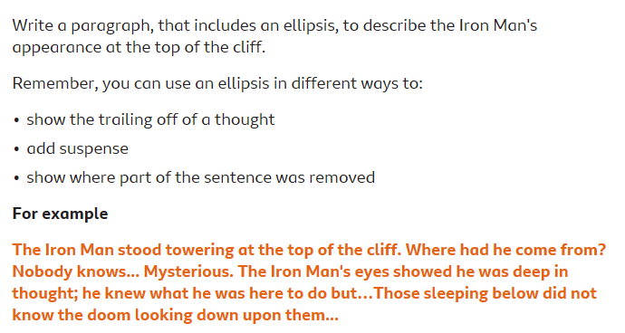
Watch the clip of the Iron Man.

Slide 5
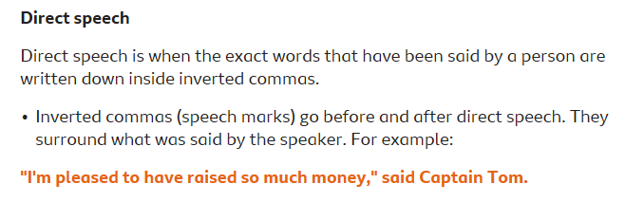
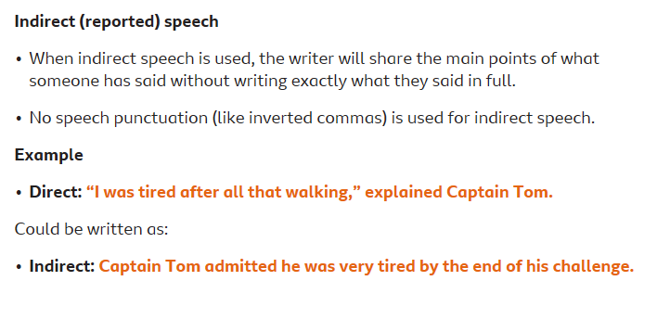
Can I use direct and indirect speech and punctuate it properly?
Watch the BBC Bitesize clip.
https://www.bbc.co.uk/bitesize/articles/zm63c7h

Slide 6
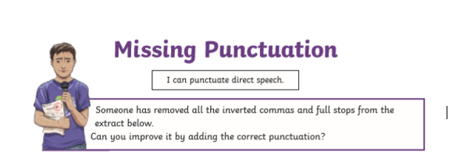
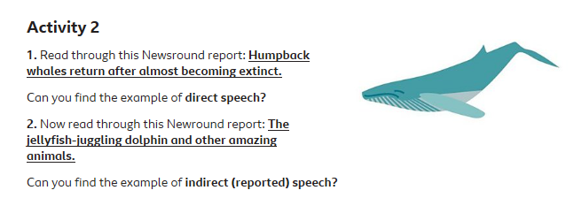
Complete Activities 1, 2 and 3 on Purple Mash
Activity 1
Humpback whales
https://www.bbc.co.uk/newsround/50057552
Jellyfish-juggling
https://www.bbc.co.uk/newsround/49316411

Slide 7
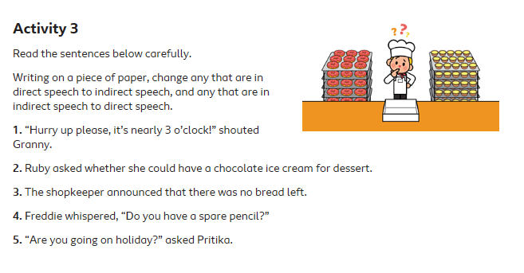

Slide 8

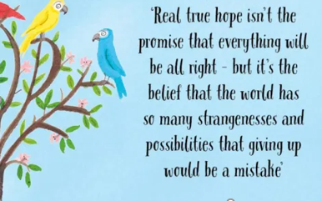
Reading Together for Pleasure
Miss Lodge, kindly bought us this lovely book ‘The Book of Hope’ just before the Christmas holiday. We thought it would be nice to share everyday ,some of the words and pictures to provide you with a little bit of comfort, inspiration and entertainment!
Hope you enjoy hearing our voices.

Slide 9
