Slide 1
English
28/01/2021

Slide 2
Reading Activity
Please see the next slides for your group`s activity
Let me know if you can`t remember which Reading group you are in
You will need a pencil or pen, and paper

Slide 3
Groups 1 and 2
2Do Purple Mash task
The Kite – read through and answer Set A questions

Slide 4
Groups 3 and 4
2Do Purple Mash task
My Best Friend – read through the text carefully, underlining the key points
Then answer Set A questions
Leave set B for tomorrow

Slide 5
Handwriting + Spellings Group 3
Suffixes ending in –sion and -tion
The suffix with the /shun/ sound can be spelled in two ways: -sion and -tion.
Root words ending in ‘t’ or ‘te’ lose these final letters and have the suffix -tion added. Root
words ending in ‘de’, ‘d’ or ‘se’ lose these final letters and have the suffix -sion added.

Slide 6
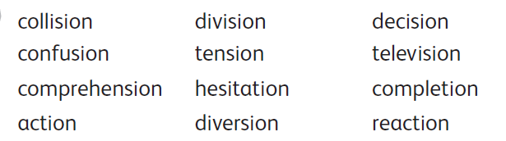
Group 3 Handwriting and Spelling list

Slide 7
Spelling group 3
Then have a go at Phase 5 and 6 games on
https://www.phonicsplay.co.uk/resources
Or practise, play games and test yourself on Spelling Frame https://spellingframe.co.uk/spelling-rule/17/13-Endings-which-sound-like--spelt%E2%80%93tion%E2%80%93sion%E2%80%93ssion%E2%80%93cian-(1-of-2)

Slide 8
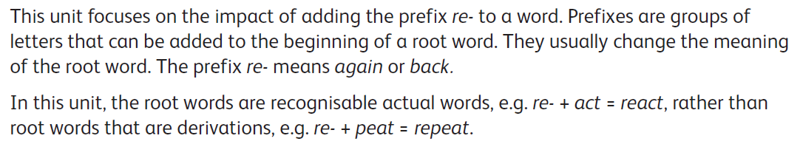
Handwriting and Spellings Group 2

Slide 9
Handwriting + Spellings Group 2

Slide 10
Group 2 Spellings
Then have a play around with the different games and tests on
https://spellingframe.co.uk/
And
https://www.phonicsplay.co.uk/resources

Slide 11
Handwriting + Spellings Group 1
This week we are looking at words with the letter or sound `g` in them
These words could begin with g or j, or contain g in the middle
Some of these words have a different sounding `g` to others – can you spot these?
sledge jet orange bridge jar badge
giant hedge joke magic huge glove

Slide 12
Handwriting + Spellings Group 1
Try the Spelling Frame practise, games and tests on https://spellingframe.co.uk/spelling-rule/78/1-The-sound-spelt-as-ge-and-dge-at-the-end-of-words
Or the Phonics Play website https://www.phonicsplay.co.uk/resources

Slide 13
Handwriting
Use the spelling sheets to practise your handwriting. You will not be able to trace the word, unless you can print the sheets off, but you will be able to copy it.
Practise 3 words per day on lined paper and then have a go at writing sentences with those words in
Remember, it is quality joined writing that we are looking for, with your proper tripod grip
You can also practise other letters and words via https://www.letterjoin.co.uk using the username lj8493 and the password L (capital l)

Slide 14
Grammar
This week we are looking at joining sentences
We join different ideas in one sentence by using conjunctions
This week we are focusing on co-ordinating conjunctions
We can remember these through the acronym FANBOYS
For And Nor But Or Yet So

Slide 15
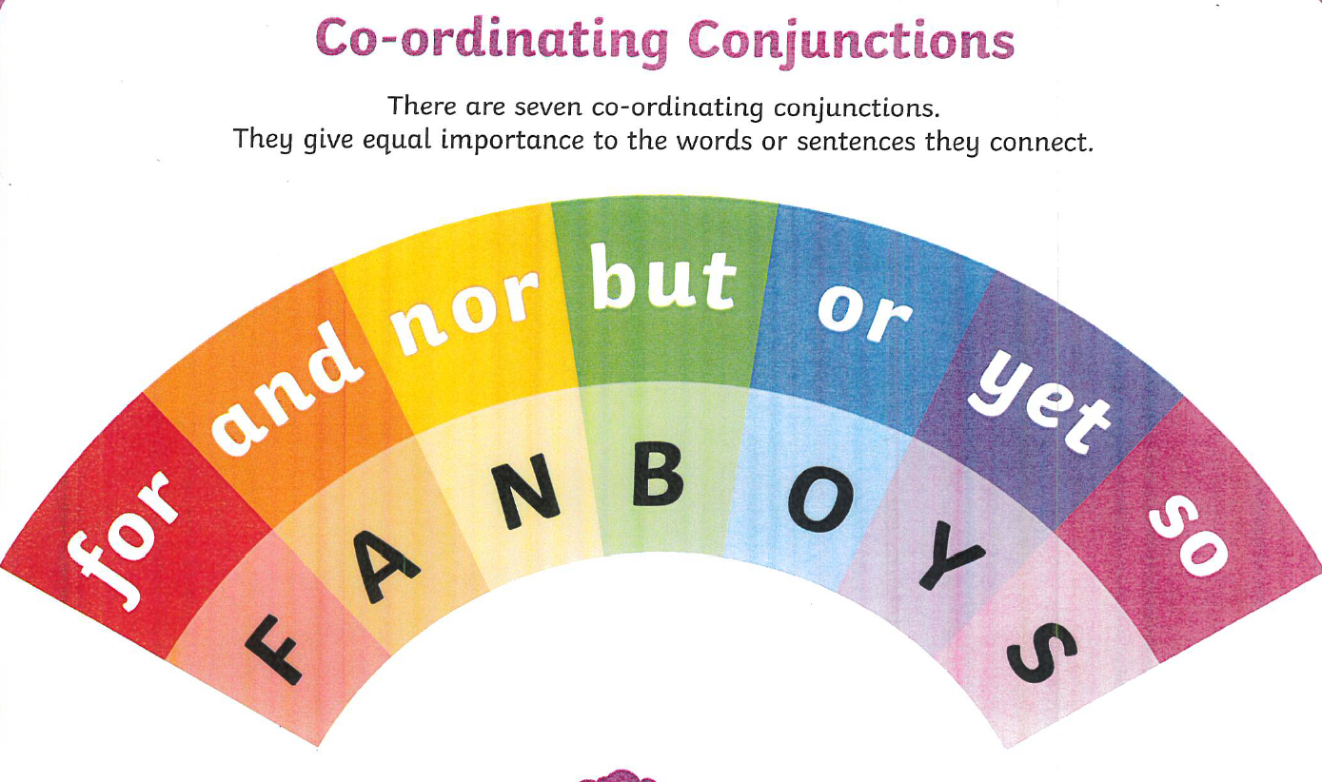

Slide 16
Therapy
On 2Do Purple Mash have a go at the task called Thursday GPS

Slide 17
Newspaper reports
What powerful words or phrases did you find yesterday?
Did you find adjectives, verbs or adverbs?
Next, read Chapter 14 of Street Child on 2Do Purple Mash (some of you may have read this already, but it will be good to recap anyway).
Imagine you are going to turn this Chapter into a newspaper report.

Slide 18
Newspaper report – your task
Firstly, work out what might be your main heading and sub-headings
For example, your main heading might be
Jim goes to the pub for tea!
A sub-heading might be
Jim gets paid or Mutton stew

Slide 19
Powerful words and phrases
Secondly, can you add some powerful words and phrases underneath those headings to make me want to read more?
For example
Mutton stew
One foggy night Grimy Nick invited Jim to the pub. It was dark and noisy in the pub, but the stew was hot. With a crash, Jim fell off his stool!
Can you use conjunctions in your sentences?
I will be really interested to see what you come up with!

