Slide 1
English 26/01/2021

Slide 2
Reading Activity Please see the next slides for your group`s activity
Let me know if you can`t remember which Reading group you are in
You will need a pencil or pen, and paper

Slide 3
Groups 1 and 2
2Do Purple Mash task
Song of the Seasons

Slide 4
Groups 3 and 4
2Do Purple Mash tasks
Read through the Powerpoint R4f Therapy and have a go at the practise questions
Then try Therapy Test 1

Slide 5
Handwriting + Spellings Group 3
Suffixes ending in –sion and -tion
The suffix with the /shun/ sound can be spelled in two ways: -sion and -tion.
Root words ending in ‘t’ or ‘te’ lose these final letters and have the suffix -tion added. Root
words ending in ‘de’, ‘d’ or ‘se’ lose these final letters and have the suffix -sion added.

Slide 6
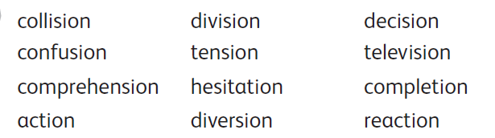
Group 3 Handwriting and Spelling list

Slide 7
Spelling group 3
Then have a go at Phase 5 and 6 games on
https://www.phonicsplay.co.uk/resources
Or practise, play games and test yourself on Spelling Frame https://spellingframe.co.uk/spelling-rule/17/13-Endings-which-sound-like--spelt%E2%80%93tion%E2%80%93sion%E2%80%93ssion%E2%80%93cian-(1-of-2)

Slide 8
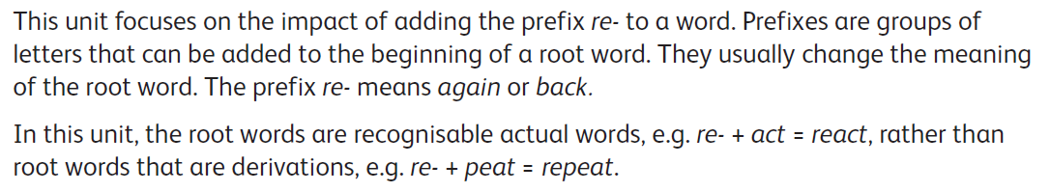
Handwriting and Spellings Group 2

Slide 9
Handwriting + Spellings Group 2

Slide 10
Group 2 Spellings
Then have a play around with the different games and tests on
https://spellingframe.co.uk/
And
https://www.phonicsplay.co.uk/resources

Slide 11
Handwriting + Spellings Group 1
This week we are looking at words with the letter or sound `g` in them
These words could begin with g or j, or contain g in the middle
Some of these words have a different sounding `g` to others – can you spot these?
sledge jet orange bridge jar badge
giant hedge joke magic huge glove

Slide 12
Handwriting + Spellings Group 1
Try the Spelling Frame practise, games and tests on https://spellingframe.co.uk/spelling-rule/78/1-The-sound-spelt-as-ge-and-dge-at-the-end-of-words
Or the Phonics Play website https://www.phonicsplay.co.uk/resources

Slide 13
Handwriting
Use the spelling sheets to practise your handwriting. You will not be able to trace the word, unless you can print the sheets off, but you will be able to copy it.
Practise 3 words per day on lined paper and then have a go at writing sentences with those words in
Remember, it is quality joined writing that we are looking for, with your proper tripod grip
You can also practise other letters and words via https://www.letterjoin.co.uk using the username lj8493 and the password L (capital l)

Slide 14
Grammar
This week we are looking at joining sentences
We join different ideas in one sentence by using conjunctions
Conjunctions are joining words
Read the following information text and watch the videos
https://www.bbc.co.uk/bitesize/articles/z6rvbdm

Slide 15
Grammar task
Read the sentences below
Can you now rewrite this text by joining the sentences together
You can use the FANBOYS sheet on the next slide to help you remember some of the different conjunctions
Year 4 went to the park. It was raining. We went inside the shelter. Once it faired up, we played on the slide. We played on the swings. However, Mr Tiffany told us we couldn`t play on the roundabout. It made him sick! We were all disappointed. We wanted to get really dizzy!

Slide 16

Grammar games
Have you tried the Karate Cats game on BBC Bitesize? https://www.bbc.co.uk/bitesize/topics/zd63xyc/articles/zdp4pg8
OR
Crystal Explorers on BBC Bitesize
https://www.bbc.co.uk/bitesize/topics/zkbkf4j/articles/zbm8scw

Slide 17
Writing activity
Newspaper Reports
Take a look at the reports below, shown on the next 2 slides

Slide 18
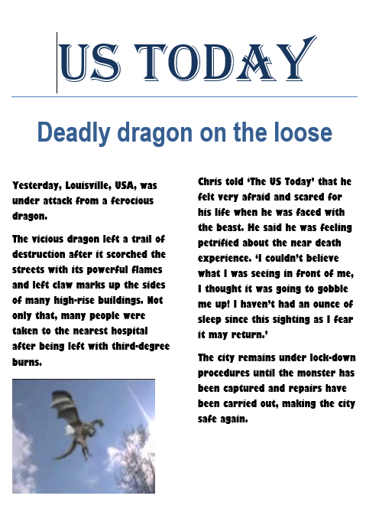

Slide 19
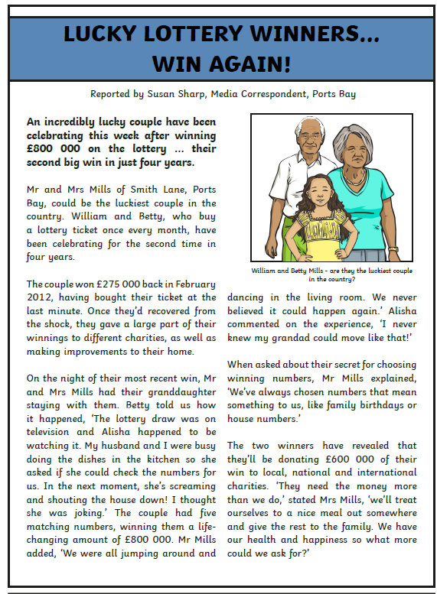
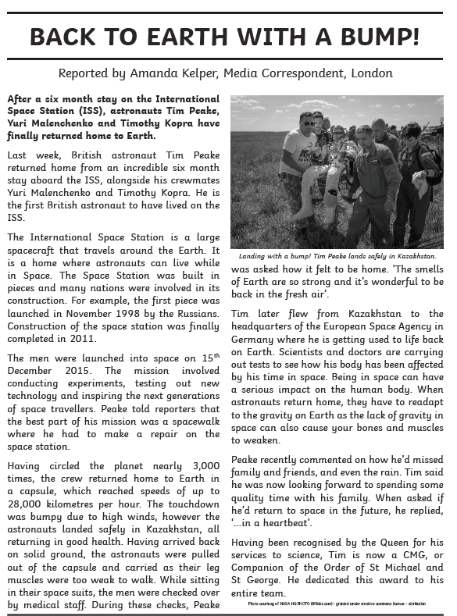

Slide 20
Features of a Newspaper Report
Can you make a bullet point list of the features that these 3 reports contain?
To get you started, here is one…
They are often written in columns
Tomorrow we will go through these and see what you came up with

