Slide 1
English 27/01/2021

Slide 2
Reading Activity Please see the next slides for your group`s activity
Let me know if you can`t remember which Reading group you are in
You will need a pencil or pen, and paper

Slide 3
Groups 1 and 2
2Do Purple Mash task
Terrific Travel Competition

Slide 4
Groups 3 and 4
2Do Purple Mash tasks
Read through the Powerpoint R4f Therapy again and have a go at the
Therapy Tests 2 and 3

Slide 5
Handwriting + Spellings Group 3
Suffixes ending in –sion and -tion
The suffix with the /shun/ sound can be spelled in two ways: -sion and -tion.
Root words ending in ‘t’ or ‘te’ lose these final letters and have the suffix -tion added. Root
words ending in ‘de’, ‘d’ or ‘se’ lose these final letters and have the suffix -sion added.

Slide 6
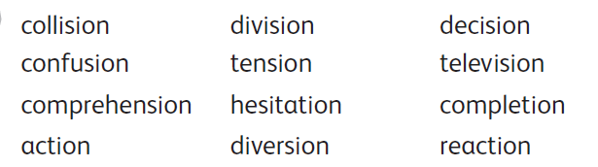
Group 3 Handwriting and Spelling list

Slide 7
Spelling group 3
Then have a go at Phase 5 and 6 games on
https://www.phonicsplay.co.uk/resources
Or practise, play games and test yourself on Spelling Frame https://spellingframe.co.uk/spelling-rule/17/13-Endings-which-sound-like--spelt%E2%80%93tion%E2%80%93sion%E2%80%93ssion%E2%80%93cian-(1-of-2)

Slide 8
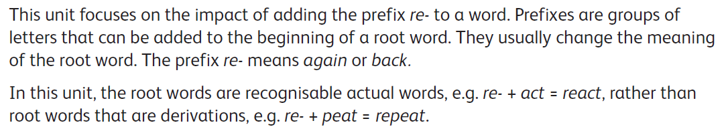
Handwriting and Spellings Group 2

Slide 9
Handwriting + Spellings Group 2

Slide 10
Group 2 Spellings
Then have a play around with the different games and tests on
https://spellingframe.co.uk/
And
https://www.phonicsplay.co.uk/resources

Slide 11
Handwriting + Spellings Group 1
This week we are looking at words with the letter or sound `g` in them
These words could begin with g or j, or contain g in the middle
Some of these words have a different sounding `g` to others – can you spot these?
sledge jet orange bridge jar badge
giant hedge joke magic huge glove

Slide 12
Handwriting + Spellings Group 1
Try the Spelling Frame practise, games and tests on https://spellingframe.co.uk/spelling-rule/78/1-The-sound-spelt-as-ge-and-dge-at-the-end-of-words
Or the Phonics Play website https://www.phonicsplay.co.uk/resources

Slide 13
Handwriting
Use the spelling sheets to practise your handwriting. You will not be able to trace the word, unless you can print the sheets off, but you will be able to copy it.
Practise 3 words per day on lined paper and then have a go at writing sentences with those words in
Remember, it is quality joined writing that we are looking for, with your proper tripod grip
You can also practise other letters and words via https://www.letterjoin.co.uk using the username lj8493 and the password L (capital l)

Slide 14
Grammar
This week we are looking at joining sentences
We join different ideas in one sentence by using conjunctions
This week we are focusing on co-ordinating conjunctions
We can remember these through the acronym FANBOYS
For And Nor But Or Yet So

Slide 15
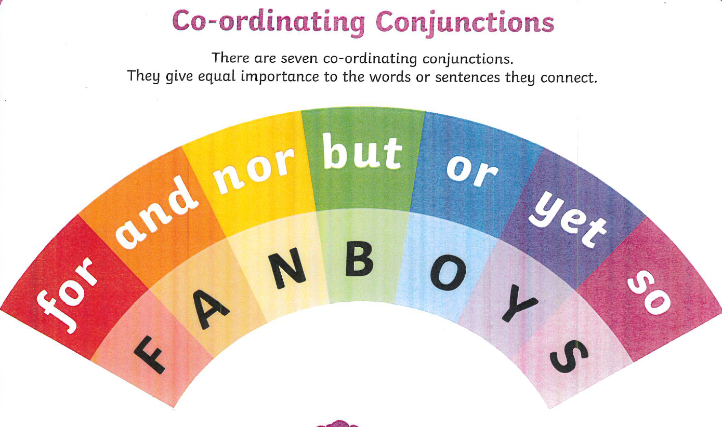

Slide 16
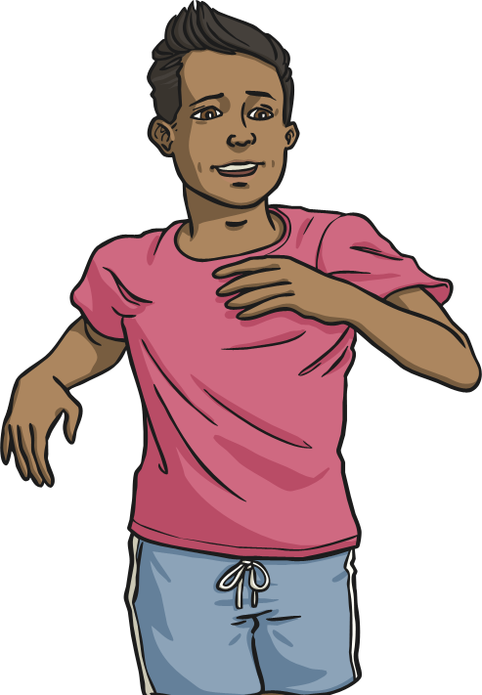
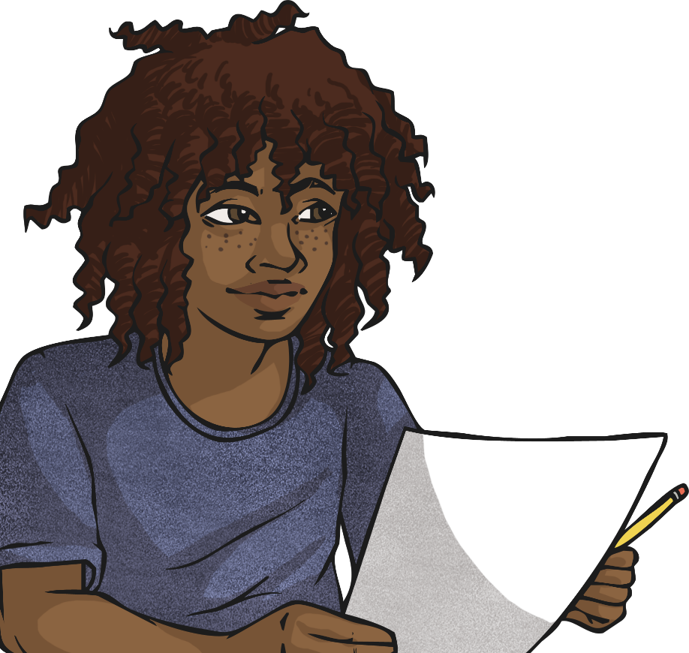

Slide 17
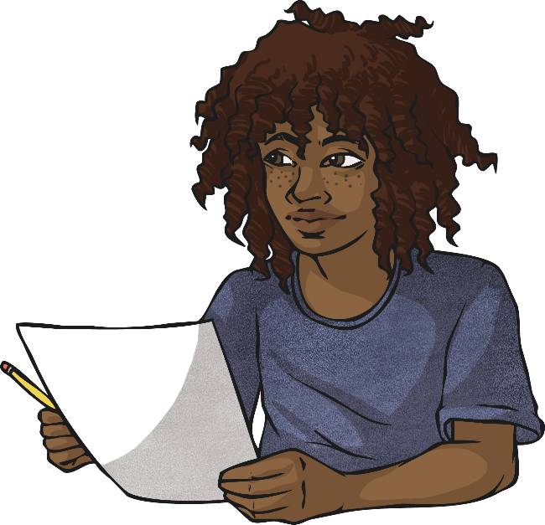
Which co-ordinating conjunction fits best?
Click the circles next to the
co-ordinating conjunctions to reveal.
Correct
Incorrect
I don’t want to do my homework tonight, Mum says I have to.
and
but
or
so

Slide 18
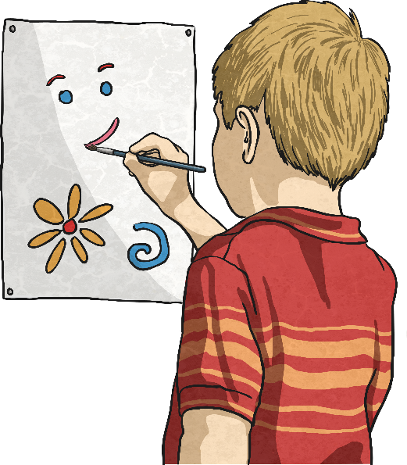
Which co-ordinating conjunction fits best?
Click the circles next to the
co-ordinating conjunctions to reveal.
Correct
Incorrect
In art class, I like to paint Jane likes to draw.
and
but
so
or

Slide 19
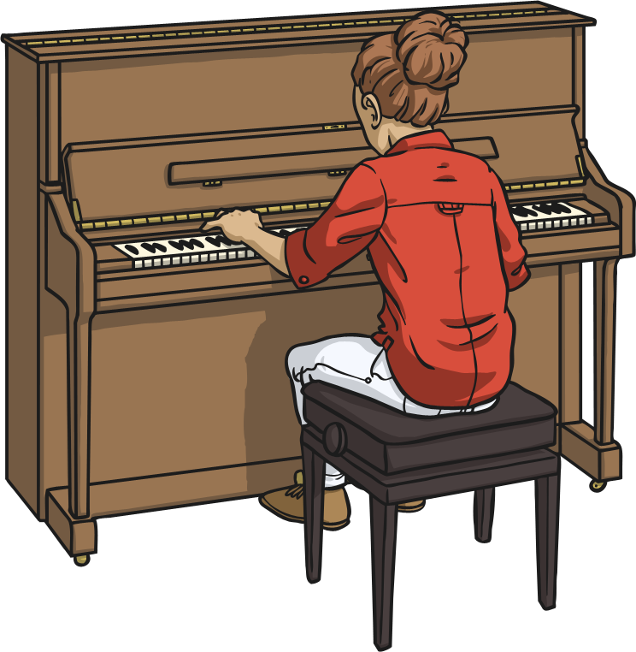
Which co-ordinating conjunction fits best?
Click the circles next to the
co-ordinating conjunctions to reveal.
Correct
Incorrect
I am going to music lessons I can learn the piano.
and
but
or
so

Slide 20
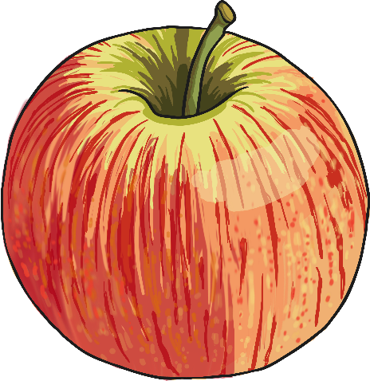
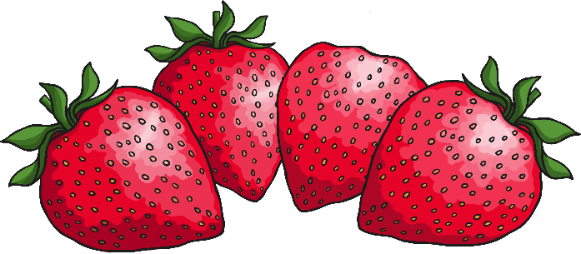
Which co-ordinating conjunction fits best?
Click the circles next to the
co-ordinating conjunctions to reveal.
Correct
Incorrect
Dad said I can eat some strawberries I can eat an apple.
and/or
but
so

Slide 21
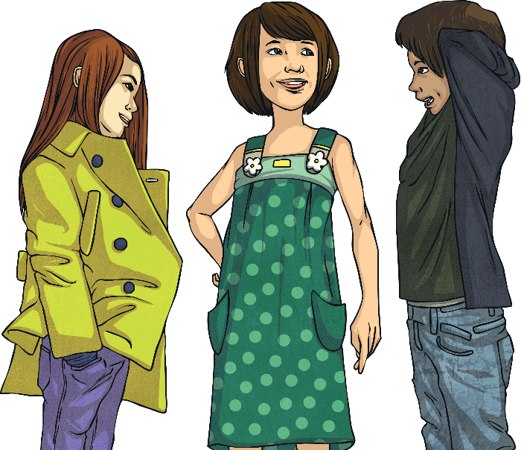
Which co-ordinating conjunction fits best?
Click the circles next to the
co-ordinating conjunctions to reveal.
Correct
Incorrect
Do you want to go now should we go later?
and
but
or
so

Slide 22
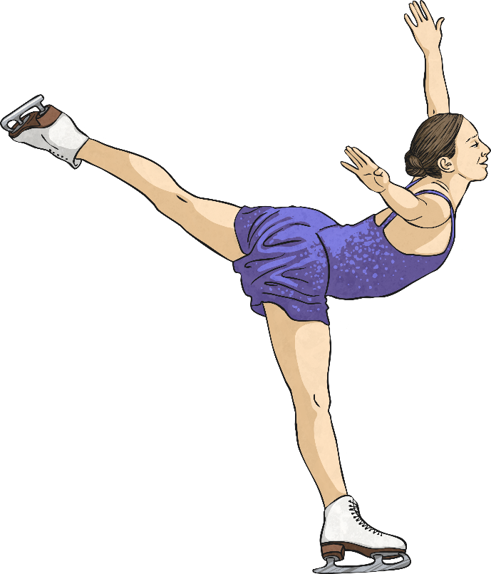
Which co-ordinating conjunction fits best?
Click the circles next to the
co-ordinating conjunctions to reveal.
Correct
Incorrect
Tom’s favourite sport is tennis Amina’s is ice skating.
and
but
or
so

Slide 23
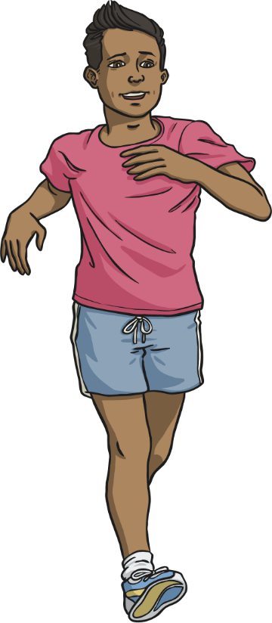
Which co-ordinating conjunction fits best?
Click the circles next to the
co-ordinating conjunctions to reveal.
Correct
Incorrect
I want to go jogging I can stay healthy.
and
but
or
so

Slide 24
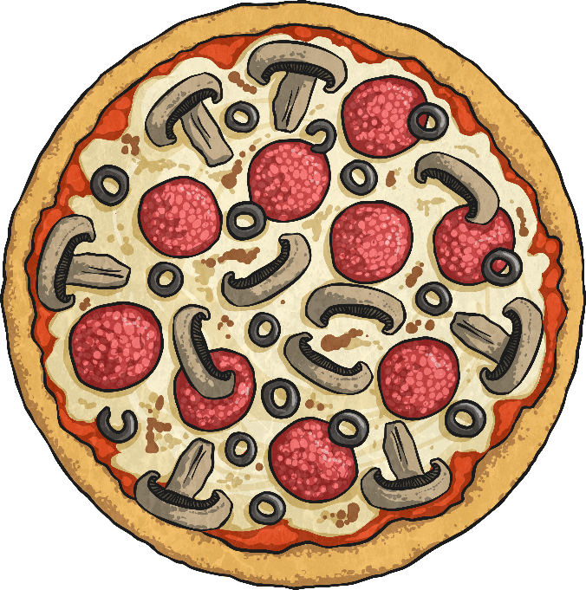
Which co-ordinating conjunction fits best?
Click the circles next to the
co-ordinating conjunctions to reveal.
Correct
Incorrect
My friend likes cheese they don’t like it on pizza.
and
but
or
so

Slide 25
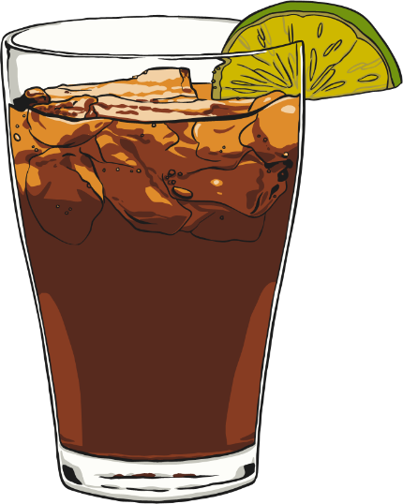

Which co-ordinating conjunction fits best?
Click the circles next to the
co-ordinating conjunctions to reveal.
Correct
Incorrect
Would you like fizzy pop would you prefer fruit juice?
and
but
or
so

Slide 26
Grammar task
Have a go at the 2Do Purple Mash tasks called
Conjunctions 1, Conjunctions 2 and Conjunctions 3
You only need to have a go at 1 of these, but if you fancy a challenge try all 3!

Slide 27
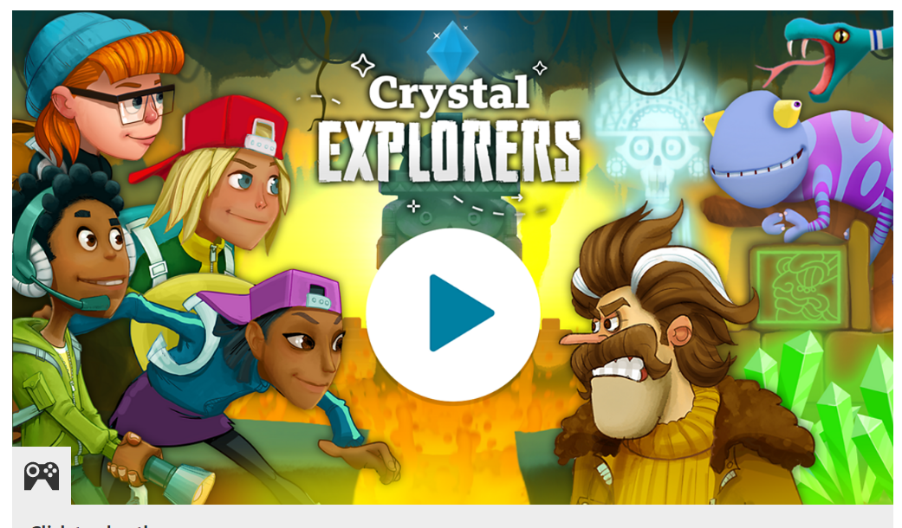
Grammar games
Have you tried the Karate Cats game on BBC Bitesize? https://www.bbc.co.uk/bitesize/topics/zd63xyc/articles/zdp4pg8
OR
Crystal Explorers on BBC Bitesize
https://www.bbc.co.uk/bitesize/topics/zkbkf4j/articles/zbm8scw

Slide 28
Writing activity
Newspaper Reports
What features did we come up with yesterday?
Have a look at the Ignite for Writing checklist to see how many you found!

Slide 29
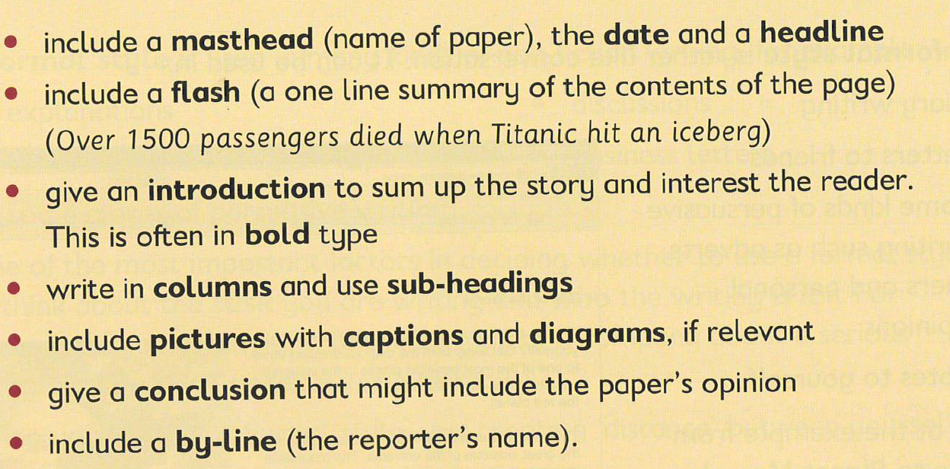

Slide 30
Newspaper reports
Next, take a look at the reports we used yesterday, shown on the next 2 slides
Can you find any powerful words or phrases that excite you and make you want to read more?
Note these down for tomorrow

Slide 31
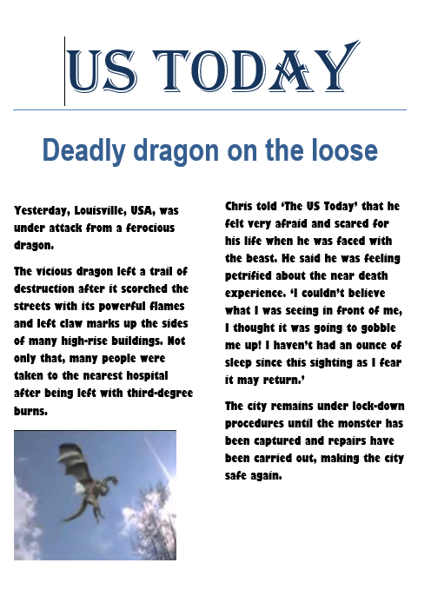

Slide 32
