Slide 1
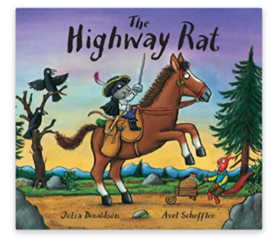
Friday 29th January 2021
English tasks

Slide 2
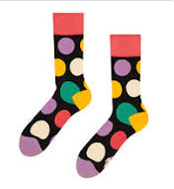
Can you knock our socks off with your neat writing?
Now that you have practised your letters on letterjoin can you practise on a piece of paper?
Can you send a picture of your writing to us?
lara.crawford@worthvalleyprimary.co.uk
steph.milner@worthvalleyprimary.co.uk

Slide 3
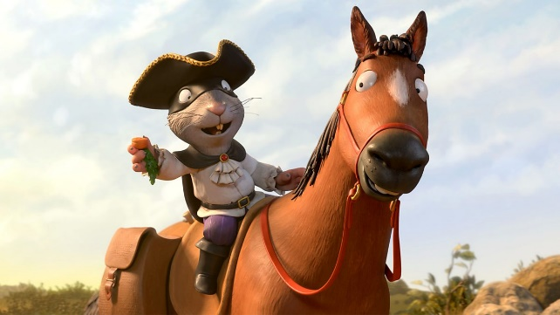
Writing Tasks
This week we are reading
The Highway Rat
by Julia Donaldson.
Can you watch the film version of this story using the link below?
https://www.bbc.co.uk/iplayer/episode/b09kkt1k/the-highway-rat

Slide 4
Writing task
Today we need to do a special job to help the Highway Rat.
He has thought very carefully about his behaviour and knows that he wats to put things right. He wants to write a special letter to all of the animals to say sorry but he does not know how to write!
Can we write one for him?

Slide 5
Remember to set your letter out clearly and correctly. We start a letter with Dear….. And end it with From….
Remember to do your neatest writing.
What might the Highway Rat want to say to all of the animals?

Slide 6
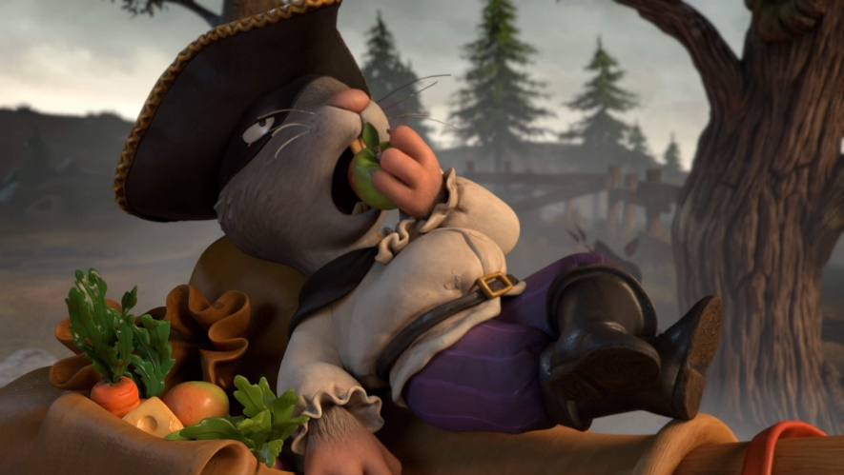
Remember we love to see your work:
you can write on paper and send a picture to us!
lara.crawford@worthvalleyprimary.co.uk
steph.milner@worthvalleyprimary.co.uk

