Slide 1
Maths
Friday 29-01-21

Slide 2

Let’s start the week with some tables.
Practise your times tables for 15 minutes on Times Tables Rockstars , click on the link and use your login and password. If you have forgotten these email Mrs Grant.
http://play.ttrockstars.com/auth/school/student

Slide 3
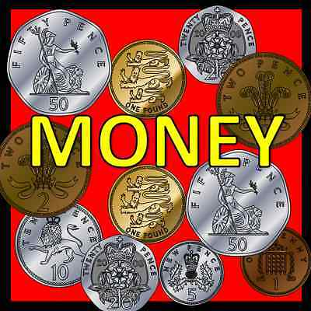
Watch Lesson Counting money, notes.
https://whiterosemaths.com/homelearning/year-2/week-10-measurement-money/
Then do the work sheets. They are on the website or if you go on Purple Mash 2Dos you should be able to type onto the sheets.
https://www.purplemash.com/sch/worth-bd22

Slide 5
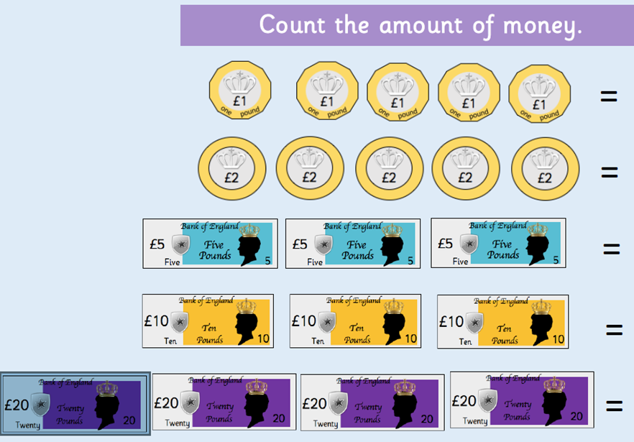
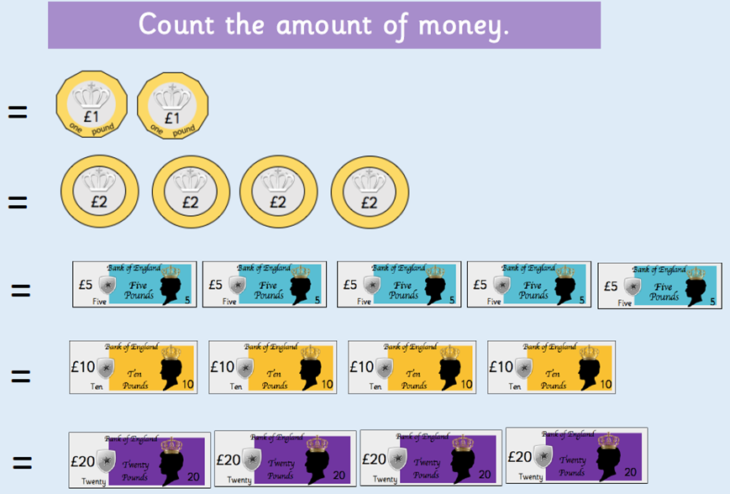

Slide 6
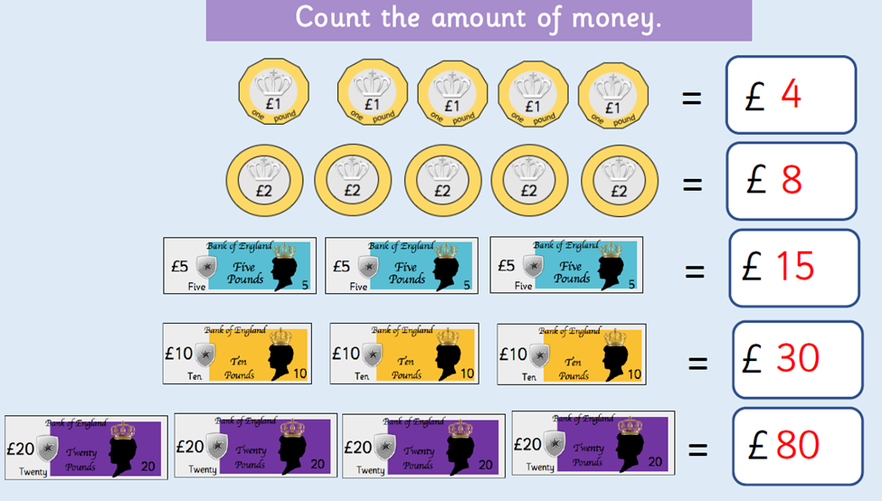
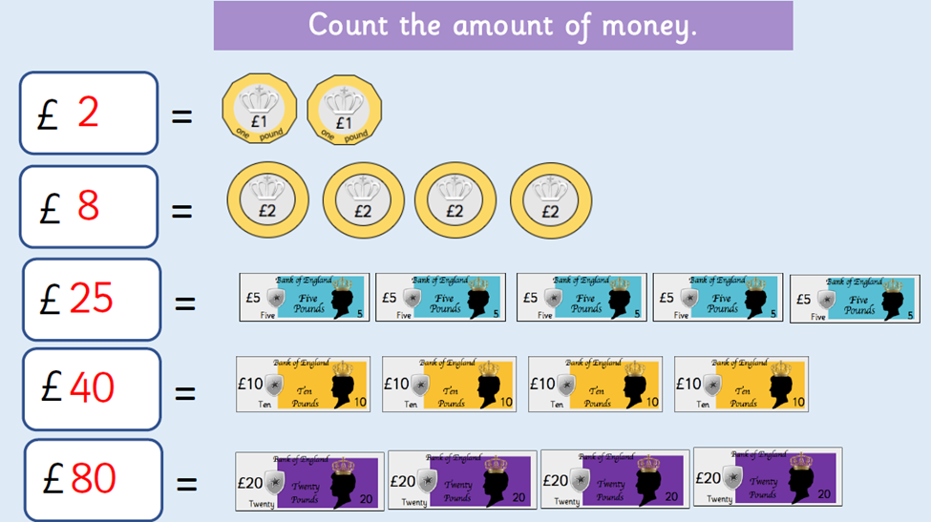

Slide 7
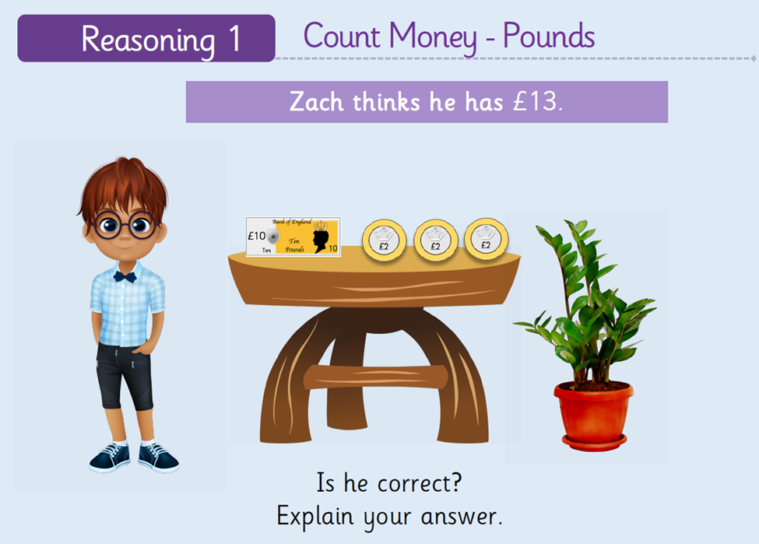
Friday Challenge.

Slide 8
