Slide 1
Maths
28/01/21

Slide 2

Times Tables Test
If you can`t remember which personal times table you are working on, then please contact me.
It`s time for the 1 minute test – simply times the numbers I say by the number of your personal times table. Just like in class! Listen now to the sound button here
Use www.timestables.co.uk to have a go at this one, as well as https://ttrockstars.com/
Try the worksheets and games, just like we have done in class, as well as singing or chanting them to your family!
Spend 10 – 15 minutes on this exercise

Slide 3
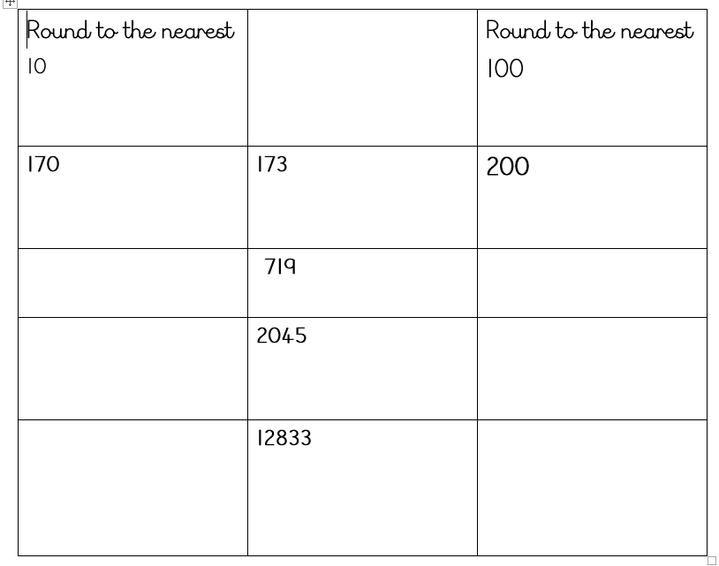
Warm-up

Slide 4
Recap
Yesterday we looked at the relationship between tenths and hundredths
Tenths are when we divide 1 whole into 10 equal parts = 1/10 or 0.1
Hundredths are when we divide 1 whole into a hundred equal parts. You can write hundredths as 1/100 or 0.01s
Here are some questions which you can answer in your head, or using pen and paper
Write 7 hundredths as a fraction and decimal
How many tenths in 1/7? How many hundredths?

Slide 5
Main teaching
Today we are learning how to write fractions as decimals.
Can I recognise decimal equivalents of fractions?
Watch the enclosed video, including quizzes and tasks https://classroom.thenational.academy/lessons/recognising-common-decimal-equivalents-6dgk6c
Then try the worksheets on your 2Do Purple Mash tasks, called
Maths 1 Thursday

