Slide 1
Maths
27/01/21

Slide 2
Times Tables
If you can`t remember which personal times table you are working on, then please contact me.
For the next 2 weeks we will be practising the 8 times table as a whole class.
Use www.timestables.co.uk to have a go at this one, as well as https://ttrockstars.com/
Try the worksheets and games, just like we have done in class, as well as singing or chanting them to your family!
Spend 10 – 15 minutes on this exercise

Slide 3
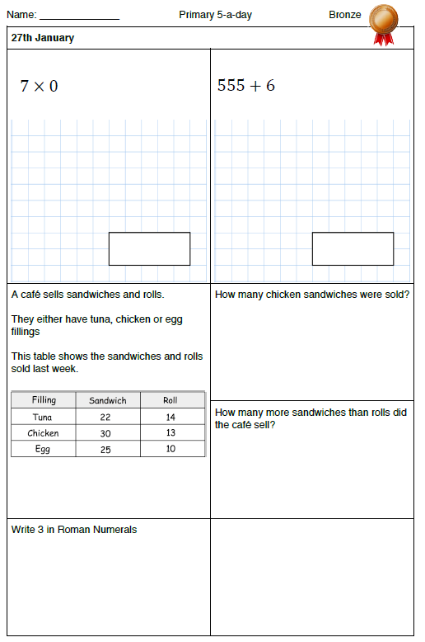
Warm-up

Slide 4
Recap
Yesterday we had a go at recognising hundredths
Hundredths are when we divide 1 whole into a hundred equal parts. You can write hundredths as fractions or decimals
Here are some questions which you can answer in your head, or using pen and paper
If 3 hundredths (or 3/100) = 0.03, what will 7 hundredths be?
How about 4/100?
What about the other way round? How many hundredths is 0.05, 0.01, 0.75?

Slide 5
Main teaching
Today we are looking at the relationship between tenths and hundredths and how these can be written as fractions and decimals.
LC: Can I recognise that hundredths arise when dividing an object by one hundred and dividing tenths by ten?
Watch the enclosed video, including quizzes and tasks https://classroom.thenational.academy/lessons/recognising-decimal-hundredths-part-2-cmukcd
Then try the worksheets on your 2Do Purple Mash tasks, called
Maths 1 Wednesday

