Slide 1
Thursday 21st January 2021
Phonics Group 2
Today we are learning to spell the tricky words: little, one, do, when, what, out.

Slide 2
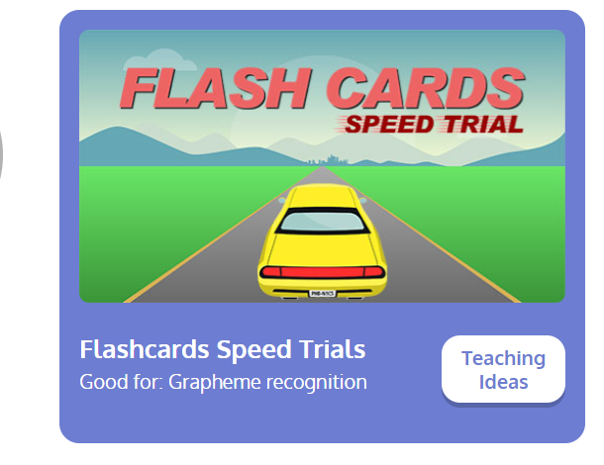
Revisit:
Can you practise the letter sounds we know so far?
https://www.phonicsplay.co.uk/resources/phase/2/flashcards-speed-trials
Phonics play:
Username: jan21
Password: home
Can you play flashcards speed trial and practise all of the phase 3 and 5a phonemes

Slide 3
Can you practise reading and writing these words? Can you ask your grown ups to say them and you write them? Can you spell them correctly?
Teach:
Today we are learning to read and spell the tricky words:
little, one, do, when, what, out
These are tricky words because they do not follow our spelling rules. We just have to learn them.

Slide 4
Apply:
Can you practise reading the sentences below?
One little frog jumped in a pond.
He likes to do that when it gets hot.
What do you think will make him get out?

