Slide 1


R.E.
Humanism
Wednesday
27.01.21

Slide 2
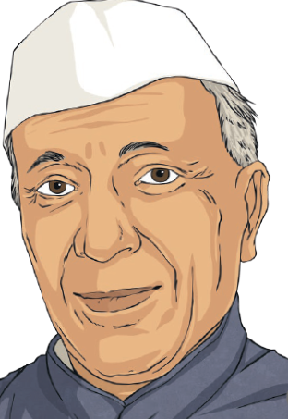
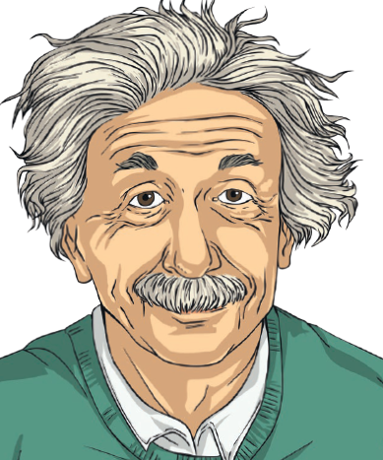
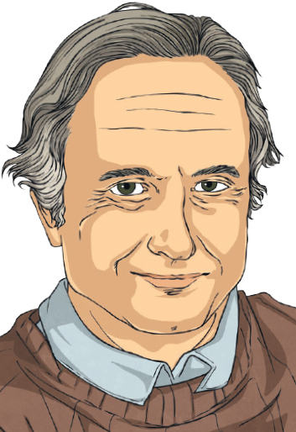
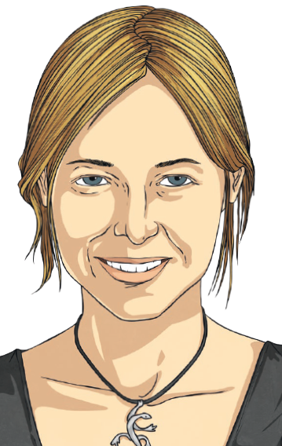
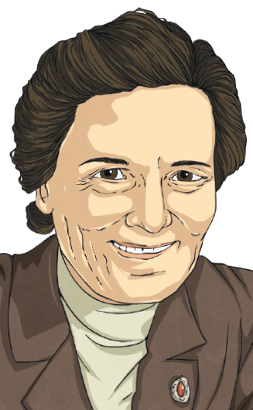

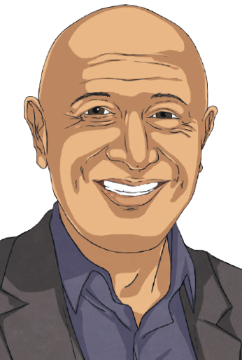

Humanist Thinkers
Can I explore, identify and compare the ideas of Humanist thinkers?

Slide 3


Influential Humanist Ideas
In the last lesson, we identified the key ideas of influential humanist thinkers.
Can you remember any of the key ideas of the influential thinkers?
Were there any common ideas?
George Eliot
Charles Darwin
Marie Curie
Mary Wollstonecraft
Equal rights for men and women
Scientist
Scientific education
Thought it wrong that women didn’t have the same rights as men
Believes that living things developed over time
Learn about and understand the world we live in using science
No belief in religion or afterlife
Possible to be good without believing in a god
Agnostic (doesn’t know if a god exists)
Test ideas to see if they are true
Wanted women to be empowered
Humans decide what is good or bad
No belief in religion
Live our lives without relying on a god
Help each other
Duty to help others
Understand one another’s point of view
Do things for the good of all human beings, not just ourselves
Learn from mistakes

Slide 4

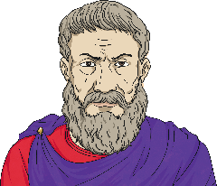
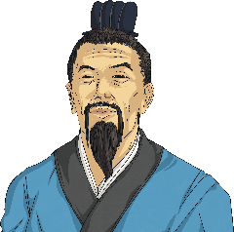
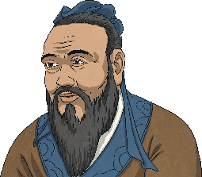
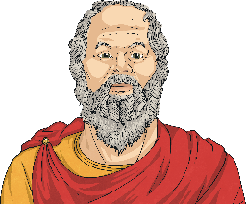
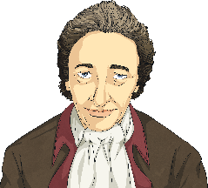
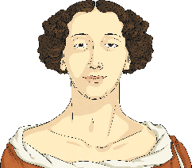
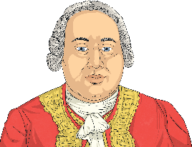
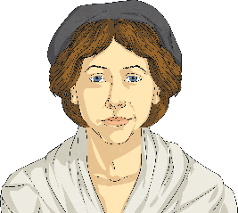
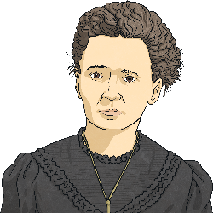
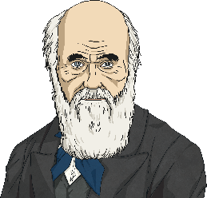
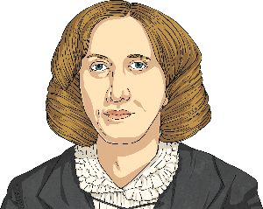
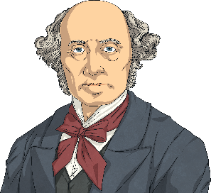
Humanist Ideas
Ancient World
Influential Thinkers
During the late 19th century and early 20th century, the term ‘humanism’ began to be used, and its system of key beliefs were developed. Earlier thinkers would not have referred to themselves as humanists but their ideas have contributed to modern humanist thinking.
Epicurus
Mencius
Confucius
Socrates
The Enlightenment Period
Thomas Paine
Aphra Behn
David Hume
Mary Wollstonecraft
The 19th Century
Marie Curie
Charles Darwin
George Eliot
John Stuart Mill

Slide 5
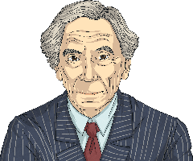
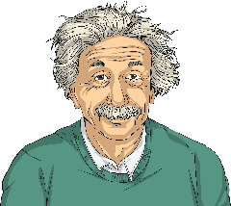
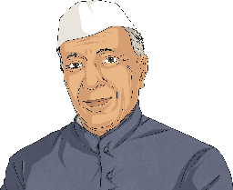
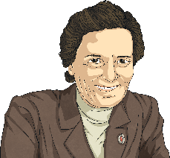

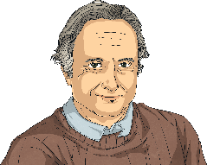
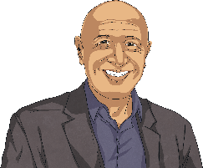
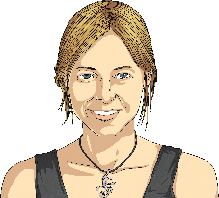
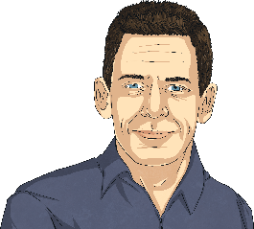
Humanist Ideas
Humanist Thinkers
These are people who would have called, or do call, themselves humanists.
The 20th Century
Bertrand Russell
Albert Einstein
Jawaharlal Nehru
Margaret Knight
Present Day
Richard Dawkins
Jim Al-Khalili
Alice Roberts
Sam Harris

Slide 6

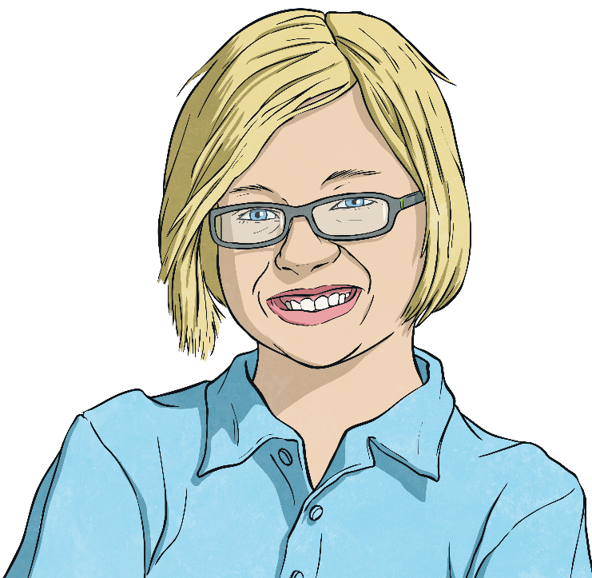
Humanist Ideas
Once the term ‘humanism’ began to be used, some people started to think of themselves as humanists. Today, we will be exploring the ideas of these more recent humanist thinkers.
Which ideas of the influential humanist thinkers do you think would be shared with the more recent humanist thinkers?
Which might not be?
Why?

Slide 7


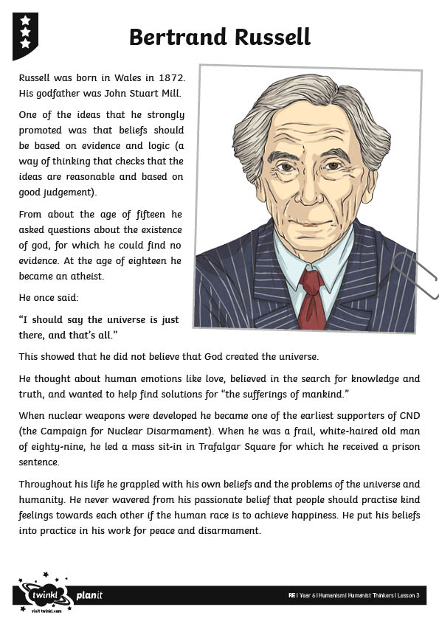
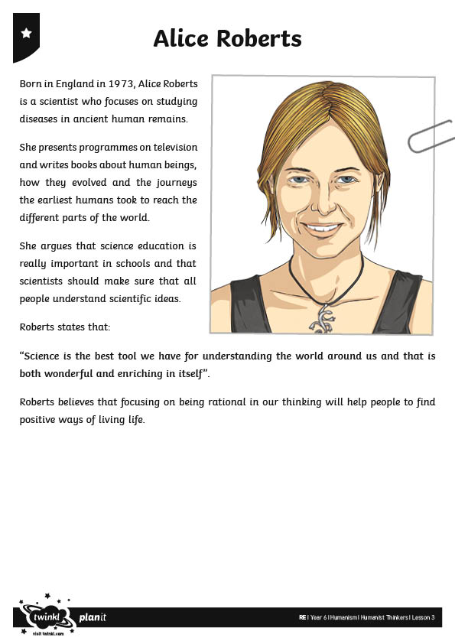
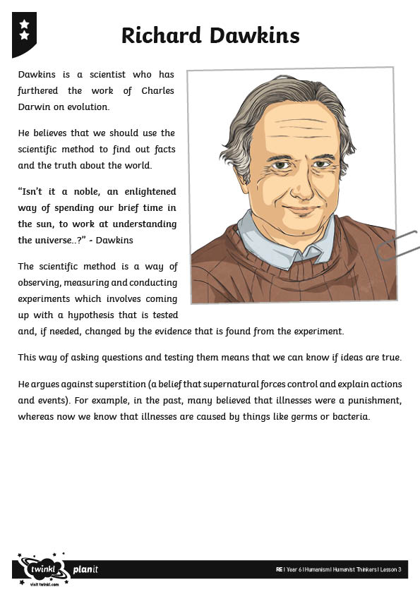
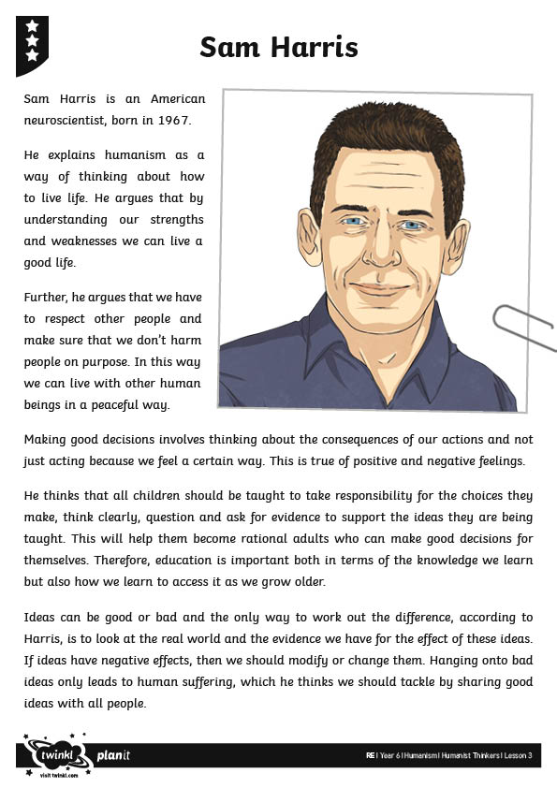
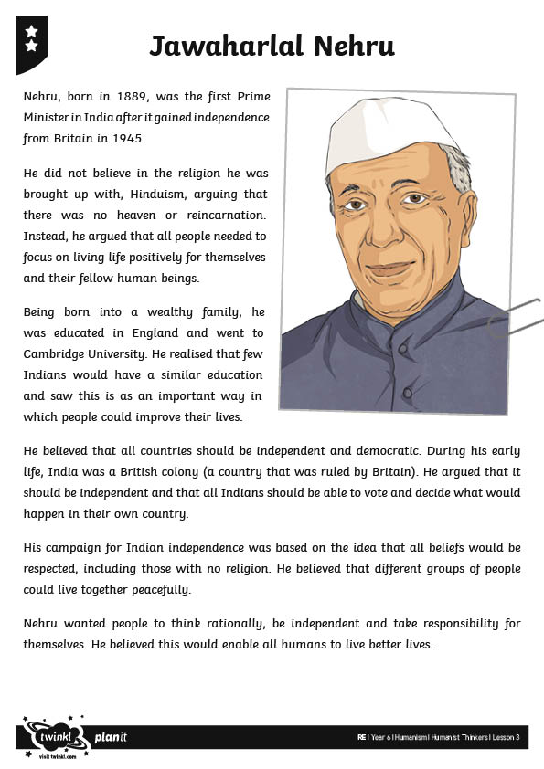
Humanist Thinkers
Read the information sheets your and underline or highlight the key ideas of each humanist thinker. Think carefully about how you might summarise their key ideas

Slide 8
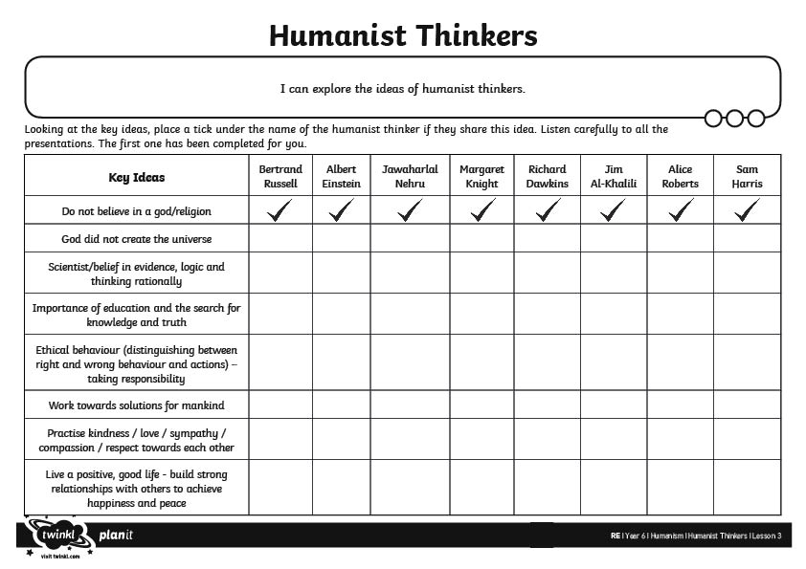
The Key Ideas
Once you have read and highlighted the key ideas of the Humanist Thinkers record the key ideas in the relevant boxes.
Did we find all the relevant information? What does it show?
Show Answers

Slide 9


Key Ideas Quiz
Can we use our completed activity sheets to help us answer the questions?
Answer:
Richard Dawkins and Alice Roberts both believe in science and education as a way of finding out what is true; and in helping people
to understand
the world.
Answer:
Science, education, ethical behaviour, working towards solutions and living a positive life.
Answer:
No God or gods, science, education, ethical behaviour, solutions for mankind, live a positive life.
Answer:
Science, education, working towards solutions and living a positive life.
Question:
What are the key ideas that Bertrand Russell and Alice Roberts agree on?
Question:
What are the key ideas that Sam Harris and Albert Einstein disagree on?
Answer:
Albert Einstein, Jawaharlal Nehru and Sam Harris.
Answer:
No God or gods and a belief in science/evidence, logic and rational thinking.
Answer:
One – that the universe was not created by a god.
Question:
Which other humanist has similar ideas to Richard Dawkins?
Question:
How many key ideas have the support of at least five thinkers?
Question:
How many key ideas have the support of at least five thinkers?
Question:
Which three humanists have the most in common?
Question:
Which ideas do all the humanist thinkers agree on?

