Slide 1
Science
26/01/2021

Slide 2
Recap on Sound
Last week we looked at pitch and frequency of sound.
If you have missed any of the lesson`s on Sound, or wish to recap, then it may be a good idea to watch these clips below
https://www.bbc.co.uk/bitesize/topics/zgffr82/articles/z3j3jty
https://classroom.thenational.academy/lessons/what-are-pitch-and-frequency-6gr64t?step=2&activity=video

Slide 3
LC: Can I explain how different sounds travel to our ears?
To start with we are going to watch some video clips below
https://www.bbc.co.uk/bitesize/topics/zgffr82/articles/zqtdpbk
Then choose some, or all, of these shorter clips below for more information https://www.bbc.co.uk/bitesize/topics/zgffr82/resources/1

Slide 4
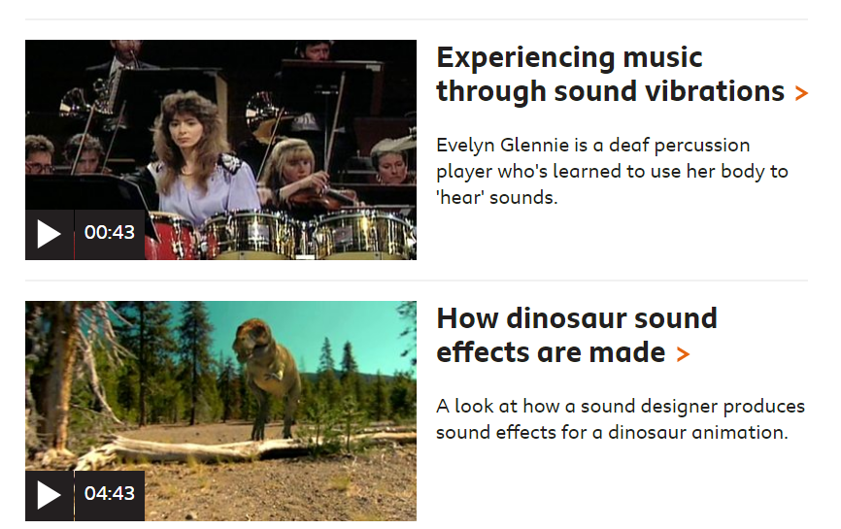

Slide 5
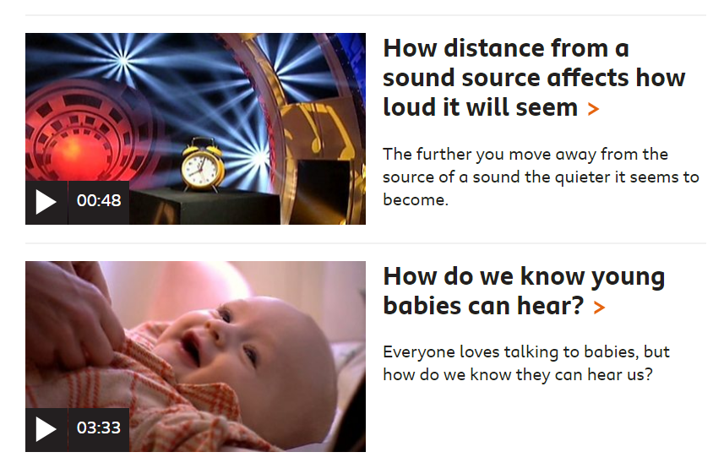

Slide 6
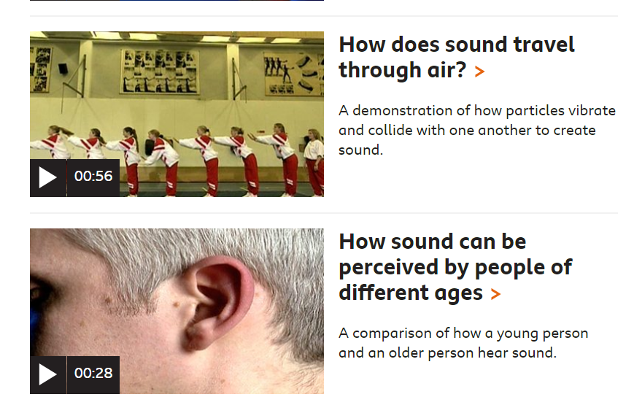

Slide 7
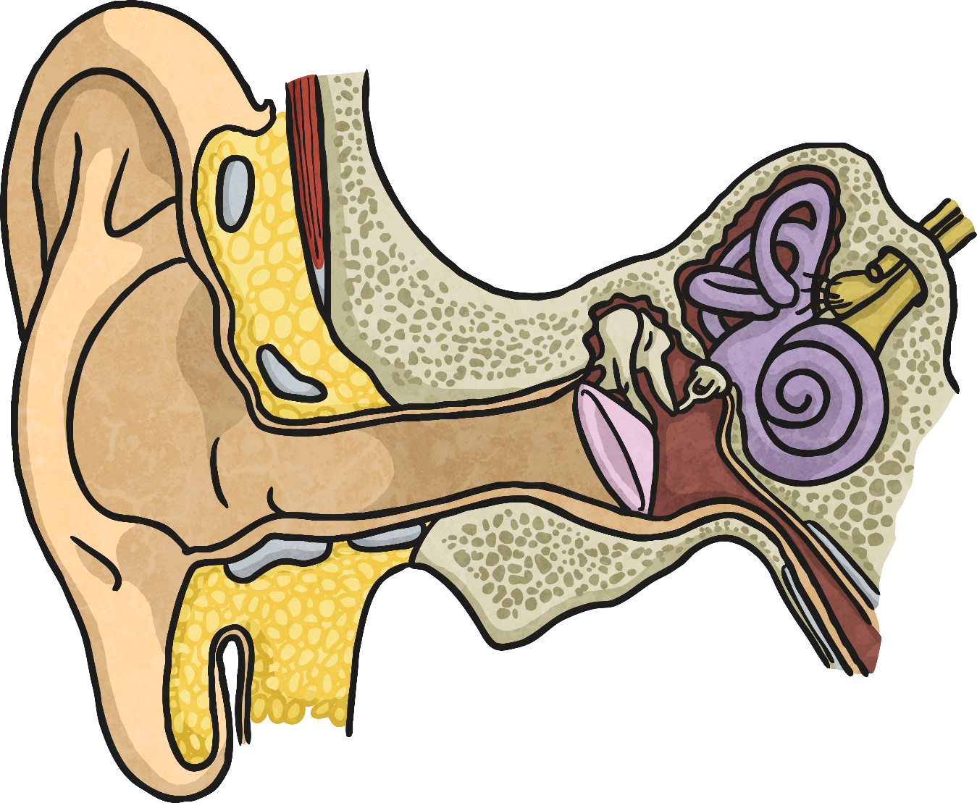

Hearing Sounds

Slide 8
Aim
I can explain how different sounds travel.
Success Criteria
I can describe how vibrations make sounds.
I can explain how vibrations change when a sound gets louder.
I can explain how loud and quiet sounds travel to our ears.

Slide 9

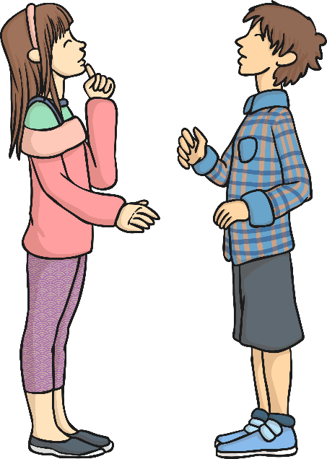






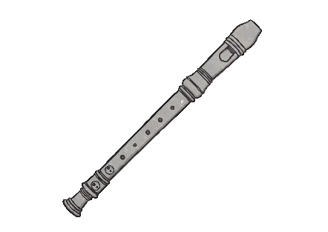


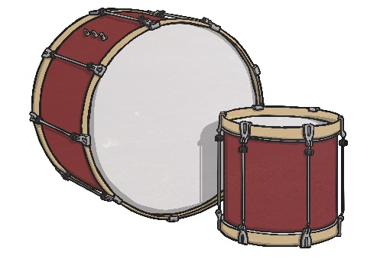




Vibrations
Sounds are made when something vibrates.
Talk to your partner about what is vibrating in each of these pictures to make a sound.

Slide 10
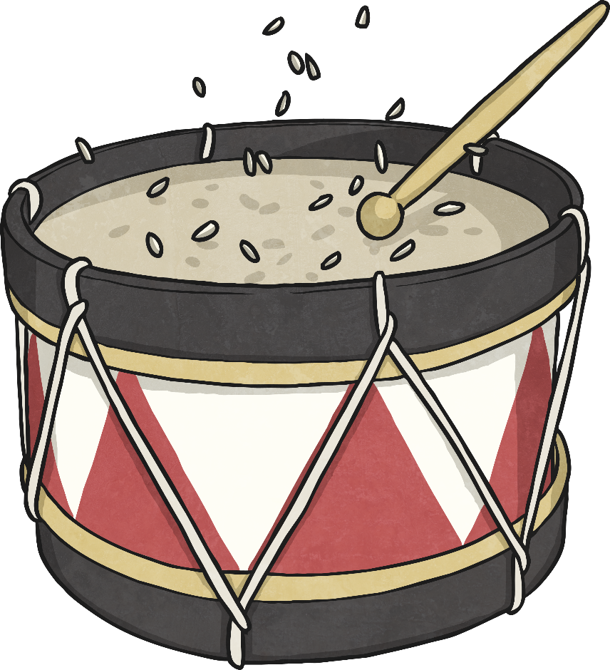
Vibrations
By placing rice on a drum, you can see the vibrations when you hit the drum, as well as hearing the sound.

Slide 11


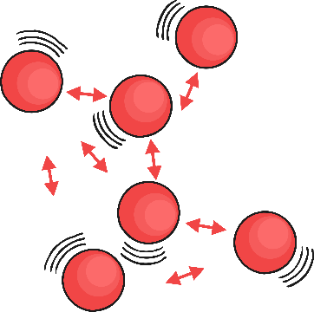
Loud and Quiet
Try this mini investigation to find out if the vibrations change when the loudness of the sound changes.
Place some rice on the skin of a drum.
Bang the drum three times: gentle, medium and hard.
Observe the way the rice vibrates each time.
Is there a link between the loudness of the sound and the size of the vibrations?

Slide 12
Your own experiment
Don`t worry if you haven`t got a drum at home, you can make your own drum using clingfilm or greaseproof paper tied over a cup or a bowl with a rubber band.
Then use the grains of rice and maybe a wooden spoon to act as a drumstick?
What happens as you bang the spoon gently, and then harder?

Slide 13
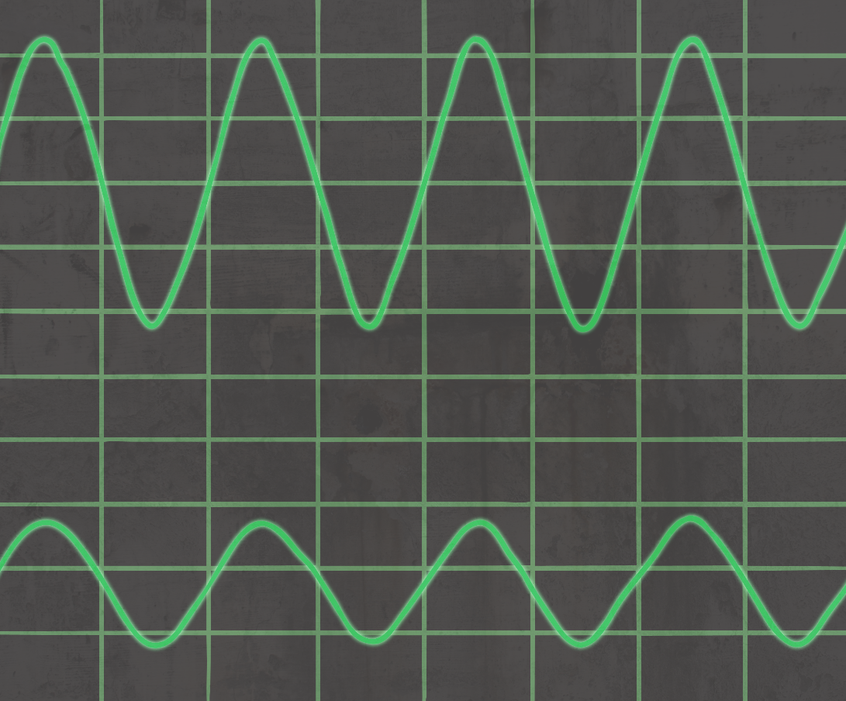
Loud and Quiet
The louder the sound, the bigger the vibration. You should have noticed that the rice grains vibrated more when you hit the drum harder, creating a louder sound.
The size of the vibration is called the amplitude.
Quieter sounds have a smaller amplitude, and louder sounds have a bigger amplitude.

Slide 14

How Does Sound Travel
So we know that sounds are caused by vibrations, and the louder sounds have
bigger vibrations.
But how do these different sounds reach our ears?
These children have been talking about their ideas.
What do you think of their ideas?
I think sound can travel through the air because the air is lighter and easier to get through than solids or liquids.
Sound moves the air from the source of the vibration into our ears. If we are listening, we will hear the sound.

Slide 15

How Does Sound Travel?
Sound can travel through solids, liquids and gases.
Sound travels as a wave, vibrating the particles in the medium it is travelling in.
So in our example, when you hit the drum, the drum skin vibrated. This made the air particles closest to the drum start to vibrate as well. The vibrations then passed to the next air particle, then the next, then the next. This carried on until the air particles closest to your ear vibrated, passing the vibrations into your ear.

Slide 16

Hearing Sounds
Once in your ear, the vibrations travel into the ear canal until they reach the eardrum. The eardrum passes the vibrations through the middle ear bones (the hammer, the anvil and the stirrup) into the inner ear. The inner ear is shaped like a snail and is called the cochlea. Inside the cochlea, there are thousands of tiny hair cells. Hair cells change the vibrations into electrical signals that are sent to the brain through the hearing nerve. The brain tells you that you are hearing a sound and what that sound is.

Slide 17
Your task
Explain how sound travels from its source to the ear.
Using scientific language, describe the difference between loud and quiet sounds
You can choose how to do this. It could be a written explanation, a labelled diagram, an informative leaflet or even poster.
Use all the information to help you.

