Slide 1
Spanish
Española
Friday 29.01.21

Slide 2

https://www.youtube.com/watch?v=QAMo_s9CFsY&feature=youtu.be&safe=active
Watch the video clip from the link above and practise the vocabulary. Then draw pictures and label in Spanish, creating a poster to show what you have learnt about shopping.

Slide 3
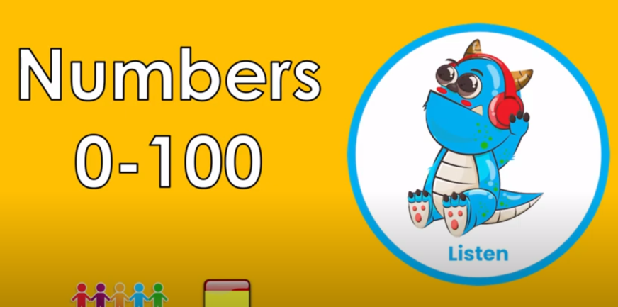
https://www.youtube.com/watch?v=yZhqRUeQ798&feature=youtu.be&safe=active
Watch the video clip from the link above and practise counting in 10’s to 100 in Spanish. Then draw pictures and label in Spanish, creating a poster to show what you have learnt about counting in 10’s.

