Slide 1
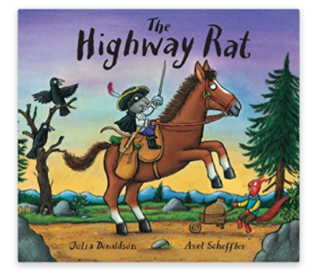
Tuesday 26th January 2021
English tasks

Slide 2
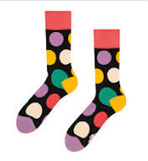
Can you knock our socks off with your neat writing?
Now that you have practised your letters on letterjoin can you practise on a piece of paper?
Can you send a picture of your writing to us?
lara.crawford@worthvalleyprimary.co.uk
steph.milner@worthvalleyprimary.co.uk

Slide 3
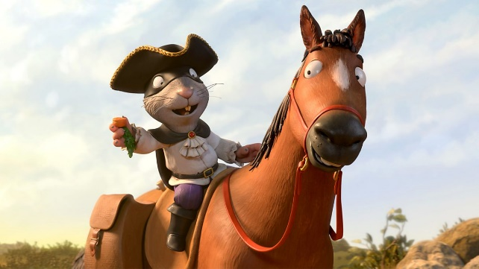
Reading and Writing Tasks
This week we are reading
The Highway Rat
by Julia Donaldson.
Can you watch the film version of this story using the link below?
https://www.bbc.co.uk/iplayer/episode/b09kkt1k/the-highway-rat

Slide 4
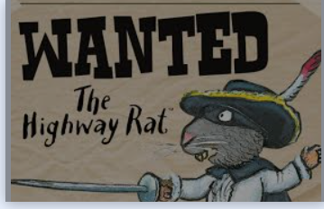
Writing Task:
The animals need our help!
We need to catch the Highway Rat. Can you make a wanted poster to help catch him so we can teach him how to share and be kind?
Remember you need to describe him carefully so that we catch the right person.

Slide 5
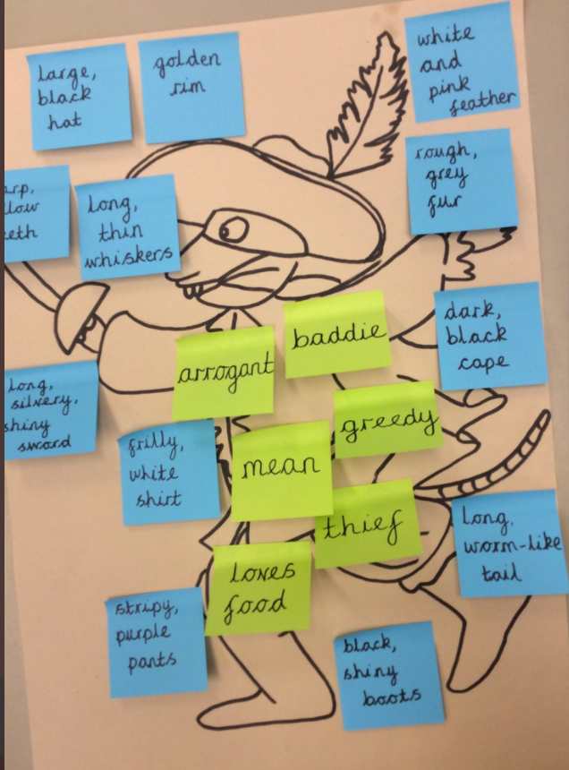
Writing task:
Can you use some of
these adjectives
in your description?

Slide 6

You might want to set your wanted poster out like this:
A picture of the Highway Rat so people know who they are looking for.
A detailed description of what he looks like and why he is ‘Wanted’ what has he done wrong?

Slide 7
Here is an example:
The Highway Rat is a baddie. The Highway Rat is beast. He loves sweet, sugary treats. He wears a long, black cloak and a white frilly shirt. He is mean and greedy because he pinches clover from a rabbit, nuts from a squirrel and even takes his own horses hay!

Slide 8
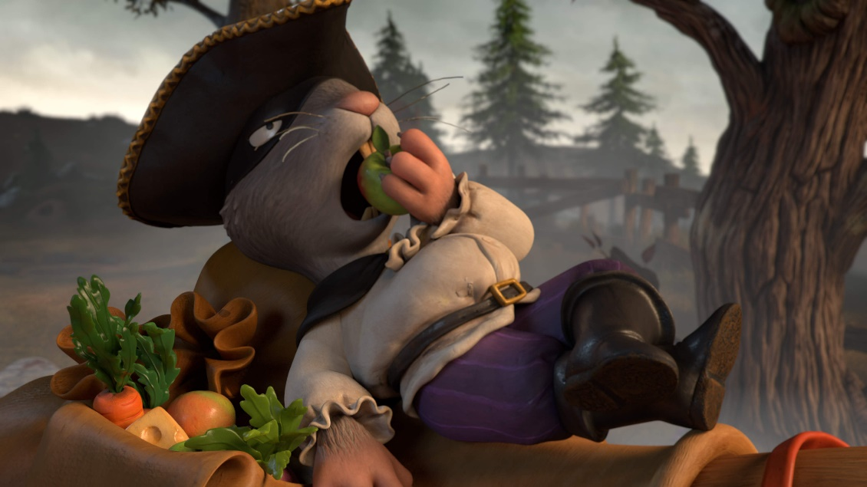
Remember we love to see your work so please email pictures to us at:
lara.crawford@worthvalleyprimary.co.uk
steph.milner@worthvalleyprimary.co.uk

