Slide 1


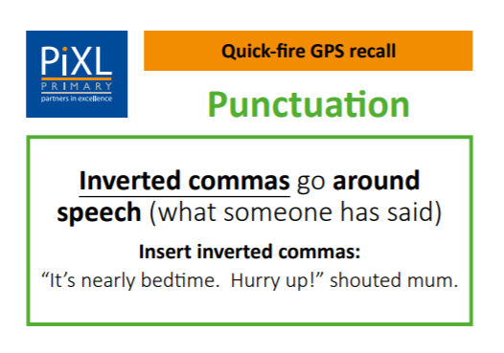
Tuesday 26th January
Can I punctuate simple direct speech accurately using speech marks?
Notes:
Ensure pupils are familiar with the technical vocabulary being used. Explain that inverted commas are also known as speech marks.

Slide 2

A conversation
What is being said?
How do you know?
What time did you arrive?
Goodness me, that is late!
I got here just before noon.
Speech bubbles have been used to show what is being said.
Meena
Karl
Hamish

Slide 3
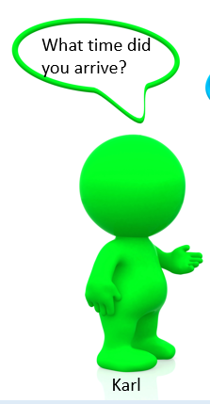
Inverted commas “ ”
Our writing would begin to look very messy if we had to draw a speech bubble every time someone spoke.
We can turn this conversation into a written text by using inverted commas.
“What time did you arrive?” asked Karl.

Slide 4

Inverted commas “ ”
“What time did you arrive?” asked Karl.
Did you notice that the inverted commas are placed on either side of the words that are spoken?
Inverted commas mark the beginning and end of direct speech.

Slide 5

Punctuation for direct speech
What other punctuation marks are used apart from the inverted commas?
“What time did you arrive?” asked Karl.
“I got here just before noon,” replied Meena.
“Goodness me, that is late!” exclaimed Hamish.
Notes:
Discuss the different punctuation used.

Slide 6
Punctuation for direct speech
Direct speech needs inverted commas and a relevant punctuation mark.
If the speech is a question, use a question mark.
If the speech is something said with strong emotion, use an exclamation mark.
For all other speech, the break between the spoken and the non-spoken words is indicated by a comma.

Slide 7
Rules for writing speech
Let’s put all this together. There are 5 steps that you need to follow to punctuate simple direct speech. They are:
Identify or decide what is being spoken.
Open the inverted commas and start speech with a capital letter.
Write what the character actually says.
Write the appropriate punctuation and close the inverted commas.
Write who said the words and how they said it, finishing with a full stop.

Slide 8

Writing speech
When writing speech, we need to work through the rules systematically.
Let’s write Olly Organisation’s speech using inverted commas.
“When writing speech, we need to work through the rules systematically,” advised Olly Organisation.

Slide 9
Practise
Insert the inverted commas into the sentences below. Remember, inverted commas mark the beginning and end of direct speech.
You look tired, said Mrs Hughes.
Is that my lunchbox? asked Grant.

Slide 10



Practise
Now you have a go on your own. Write the speech in the speech bubbles using inverted commas.
This is my favourite game.
Can you please help me?
Zac
Challenge:
Can you use a different word for ‘said’ when writing your speech?
I have found the smallest fish ever!
Micah
Zara

Slide 11
How did you do?
“Can you please help me?” asked Micah.
“I have found the smallest fish ever!” yelled Zac.
“This is my favourite game,” laughed Zara.

Slide 12
Practise
Each sentence below has a mistake. Can you find it and then rewrite the speech accurately?
“I can’t wait for the holidays, said Isla.”
“who would like to do some painting?” the teacher asked.
“Elephants are known for their large ears, tusks and their trunks,” Explained the ranger.

Slide 13
How did you do?
“I can’t wait for the holidays,” said Isla.”
“Wwho would like to do some painting?” the teacher asked.
“Elephants are known for their large ears, tusks and their trunks,” Eexplained the ranger.

Slide 14
Review
Things to remember:
All spoken words are inside the inverted commas.
All non-spoken words are outside the inverted commas.
All speech starts with a capital letter.
The ‘said’ verb (e.g. asked, shouted, explained) never has a capital letter.
The break between the speech and the non-spoken part will be either a comma, a question mark or an exclamation mark.
Always add who is speaking and finish the sentence with a full stop.
Go to Purple mash to complete the worksheet
https://www.purplemash.com/#tab/pm-home

