Slide 1
Maths 28/01/21
Practice on times tables rockstars for 15 minutes – click on the link:
ttps://play.ttrockstars.com/auth/school/student

Slide 2

Can I read and interpret information in a timetable?
Being able to read information from a timetables is really important. Especially when you are travelling. You will find them in bus stations, railway stations and airports. We have a school timetable of lessons for each class. We’ll look at how to understand and use them to answer questions.

Slide 3
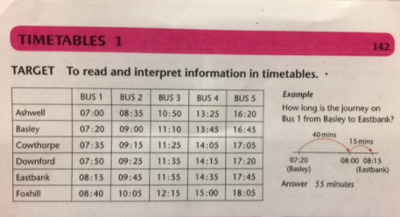
Listen to my explanations of the examples then complete the differentiated tasks on Purple Mash.

Slide 4
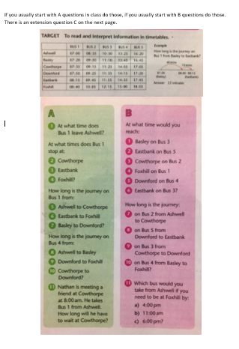
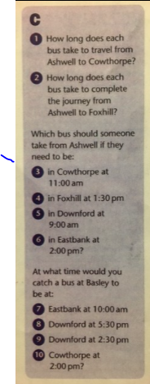
If you start with A questions in class, do those and work your way up to trying the B questions.
If you start on B questions, do those then try the extension question C.
Go to Purple Mash to find the worksheets

