Slide 1
Maths 26/01/21
Practice on times tables rockstars for 15 minutes – click on the link:
ttps://play.ttrockstars.com/auth/school/student

Slide 2
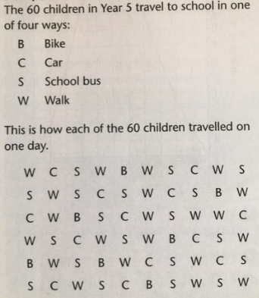

Can I organize data by recreating a frequency table?
We will carry on looking at data today. Listen to my explanation of this example again, then complete the task on Purple Mash.

Slide 3
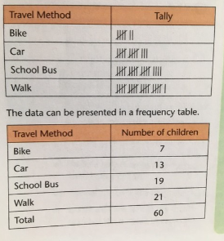
A tally chart can be made by counting in groups of five.

Slide 4
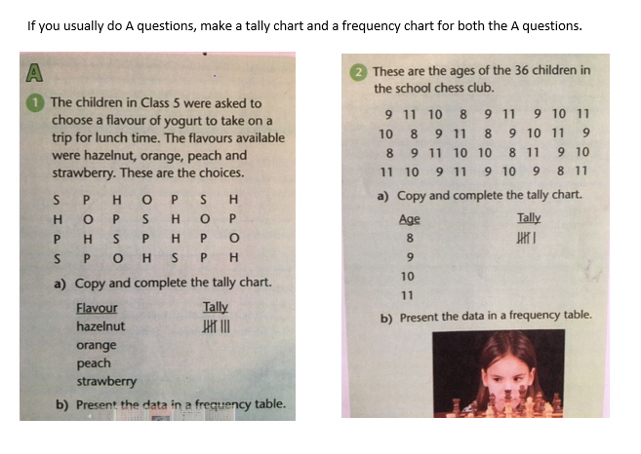
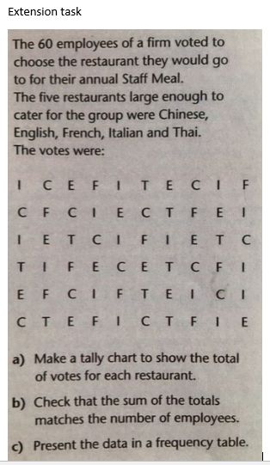
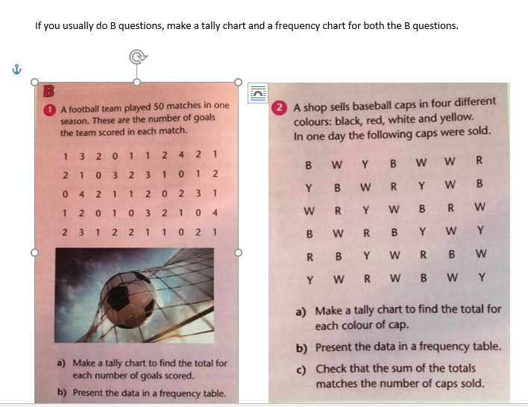
Go to the worksheets on purple mash for section A, B and an extension question.
If you completed A yesterday, now complete question B.
If you completed B yesterday, complete the extension task.
There is a new extension task on the next slide.

Slide 5
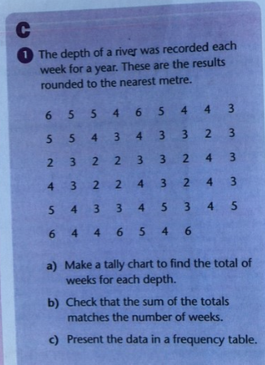
Extension Activity
Email me your answers
t.whittam@worthvalleyprimary.co.uk

