Slide 1
Wednesday 27th January 2021
English tasks.

Slide 2
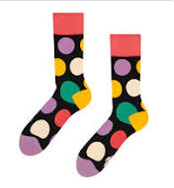
Can you knock our socks off with your neat writing?
Now that you have practised your letters on letterjoin can you practise on a piece of paper?
Can you send a picture of your writing to us?
lara.crawford@worthvalleyprimary.co.uk
steph.milner@worthvalleyprimary.co.uk

Slide 3
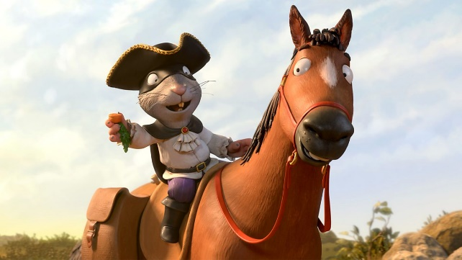
This week we are reading
The highway rat
by Julia Donaldson.
You can re-watch the film using the link below if you have forgotten what happens in the story?
https://www.bbc.co.uk/iplayer/episode/b09kkt1k/the-highway-rat

Slide 4
Writing task
Today we would like you to create a storyboard re-telling the story of the highway rat!
Split the story into six parts.
Draw a picture for each part of the story.
Write one super sentence underneath each picture, describing what is happening!

Slide 5

I have done the first one for you. Here is your example.
This is the highway rat, he is mean, he rides the highway with his pet horse looking for food to steal. He wears a hat and has a long tail.
Don’t forget your neatest handwriting, finger spaces, and full stops year one!!

Slide 6
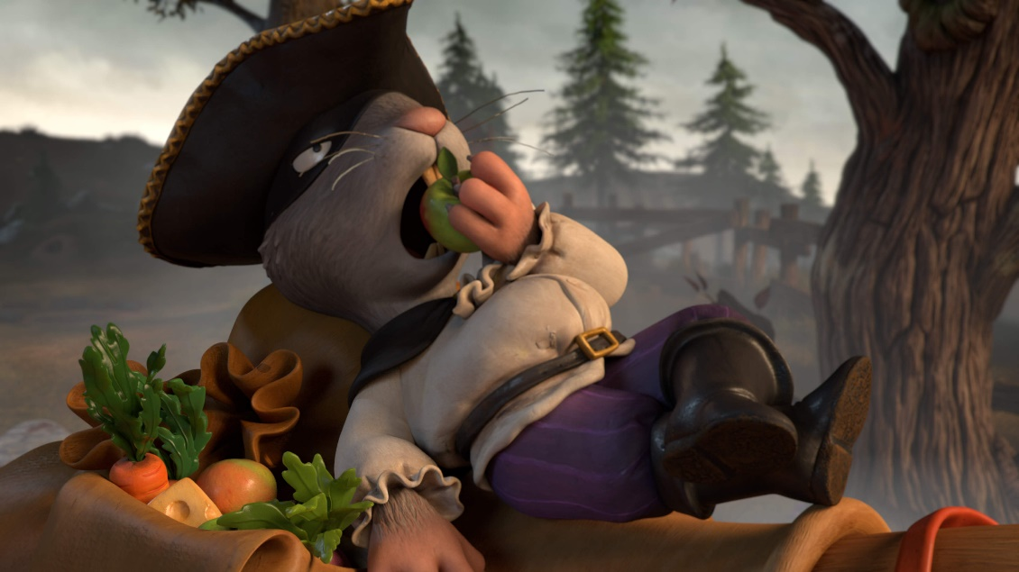
Remember we love to see your work so please email pictures to us at:
lara.crawford@worthvalleyprimary.co.uk
steph.milner@worthvalleyprimary.co.uk

