Slide 1
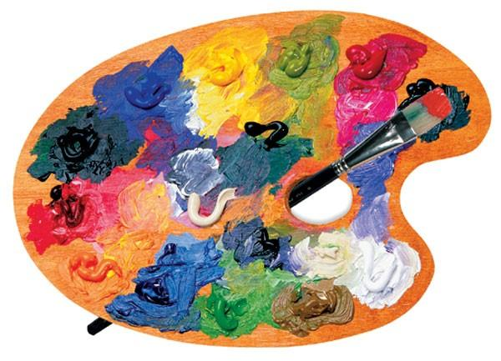
Art
03.03.2021

Slide 2

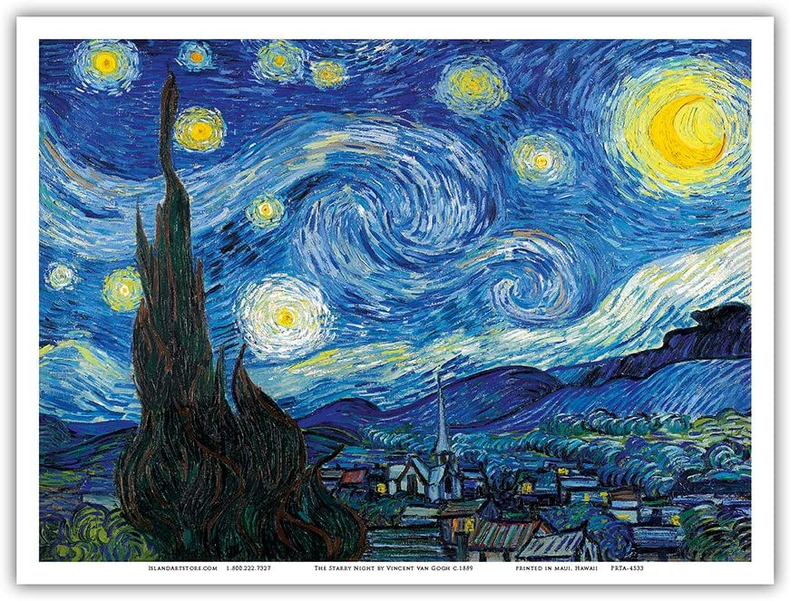
Vincent Van Gogh – Starry night

Slide 3
Vincent Van Gogh’s Starry night
Do you remember we looked at this painting and used pastels to recreate our own versions?
Today we are going to use paints and paint the sky impasto. This means like Van Gogh we are going to use different thickness and length of lines.
Using purple mash and 2 paint a picture which is in your 2Do’s I’d like you to use poster paints and create your own ‘Starry Sky’ in the style of Van Gogh.

Slide 4
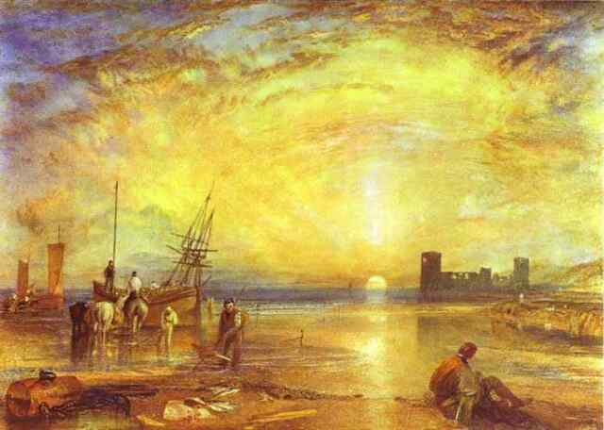
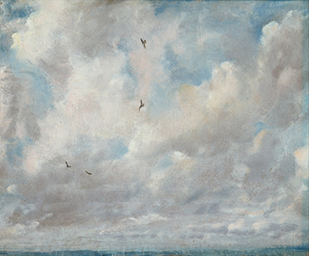
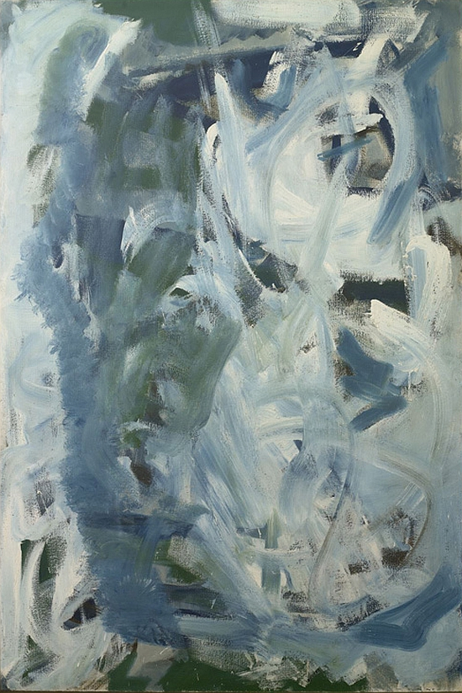
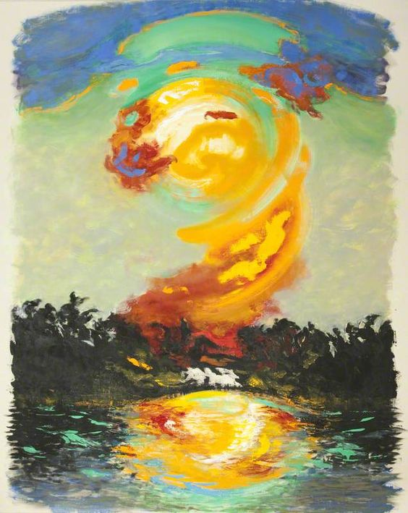
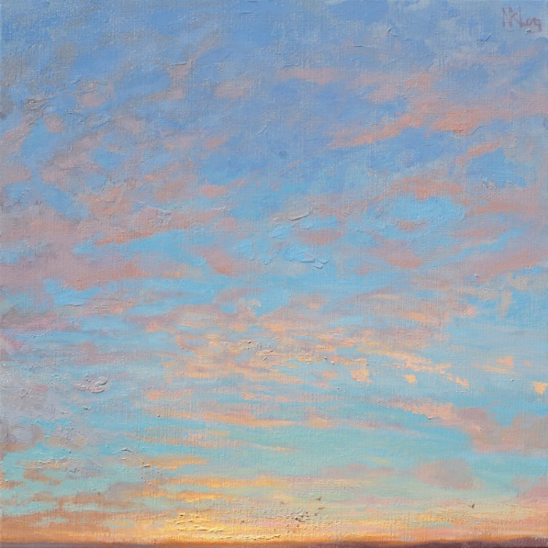
Flint Castle Wales by JMW Turner
Cloud Study by John Constable
Soaring flight by Peter Lanyon
Ascension by Norman Long
July Sunrise by Maggie Hambling

Slide 5
Your task:
I want you to look at the different styles and techniques used in the pictures in the last slide and use your imagination and whatever media you would like from Purple mash to paint a picture and create your own image of the sky.
I look forward to seeing your creations. Save them and send them to me please.

