Slide 1
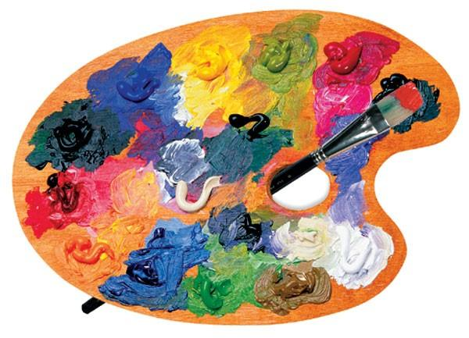
Art
04.03.2021

Slide 2
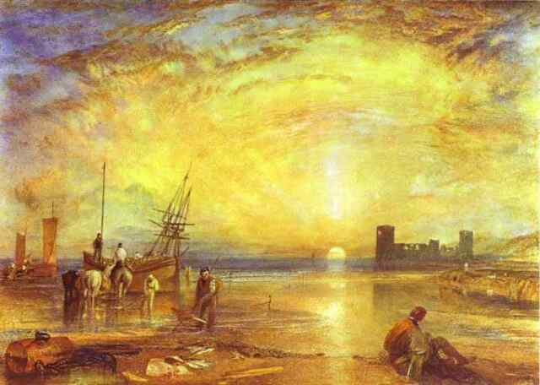
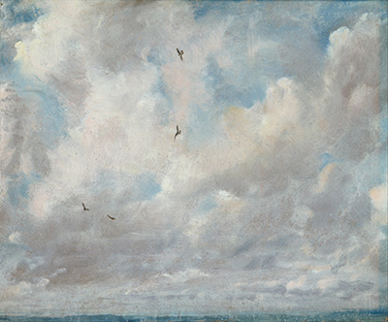
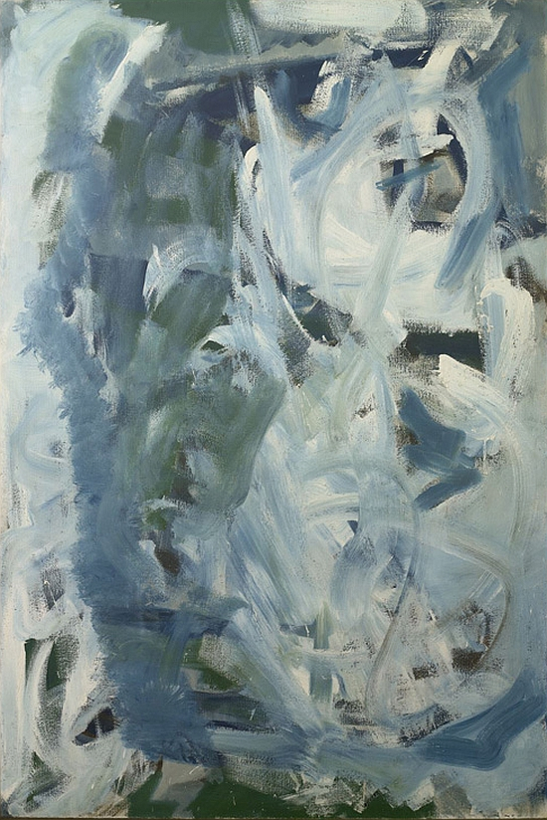
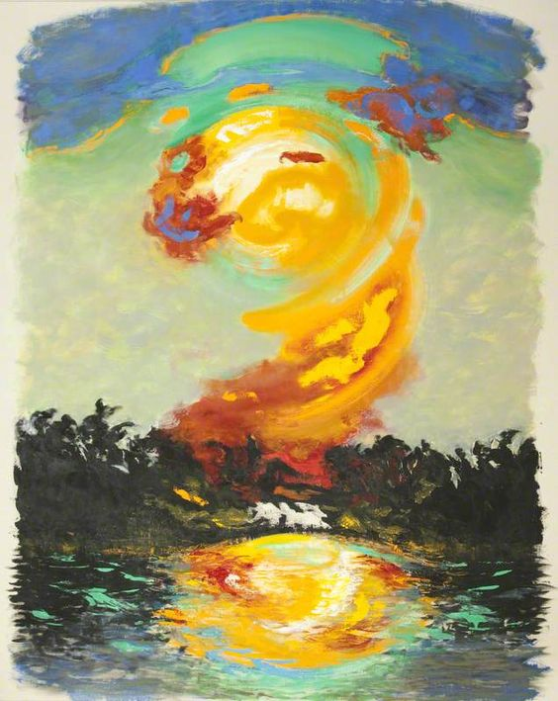
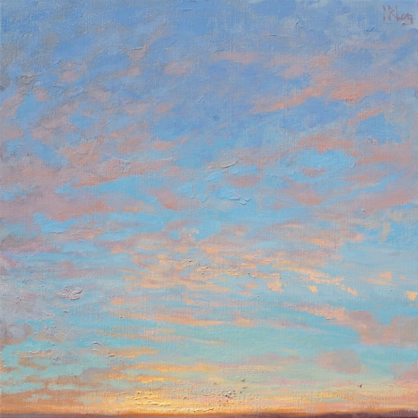

Flint Castle Wales by JMW Turner
Cloud Study by John Constable
Soaring flight by Peter Lanyon
Ascension by Norman Long
July Sunrise by Maggie Hambling

Slide 3
Your task:
I want you to look at the different styles and techniques used in the pictures in the last slide and use your imagination and whatever media you would like from Purple mash to paint a picture and create your own image of the sky.
I look forward to seeing your creations. Save them and send them to me please.

