Slide 1
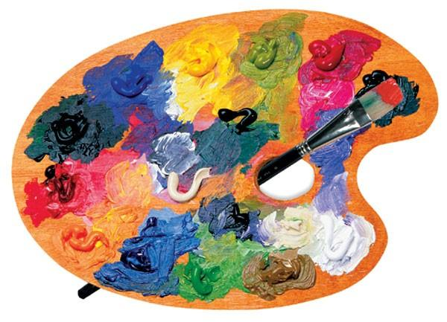
Art
25.02.2021

Slide 2
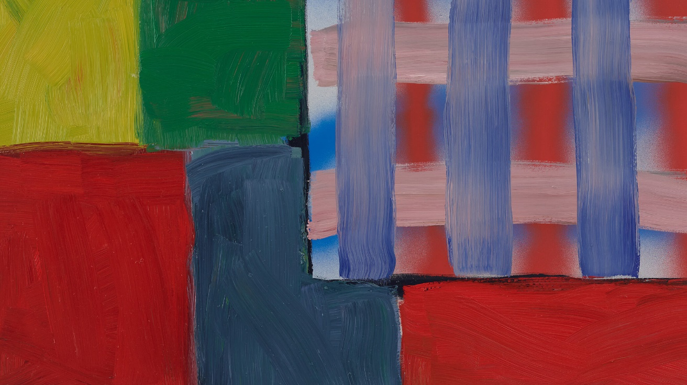

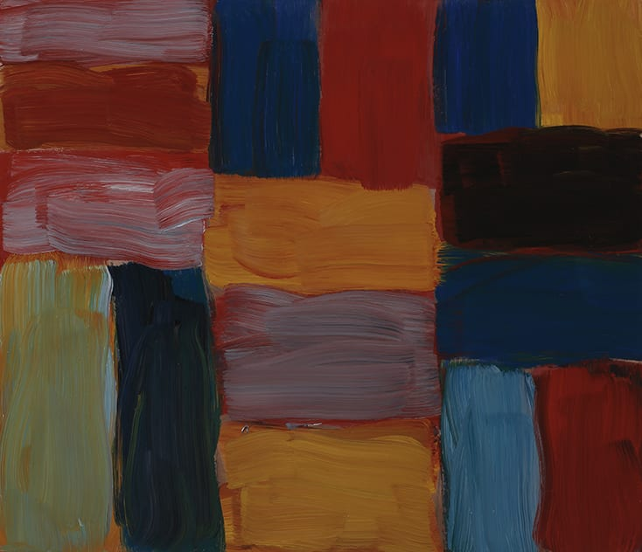
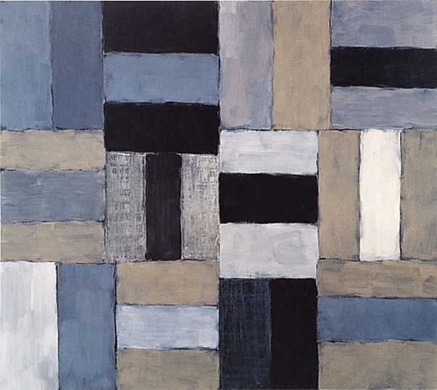
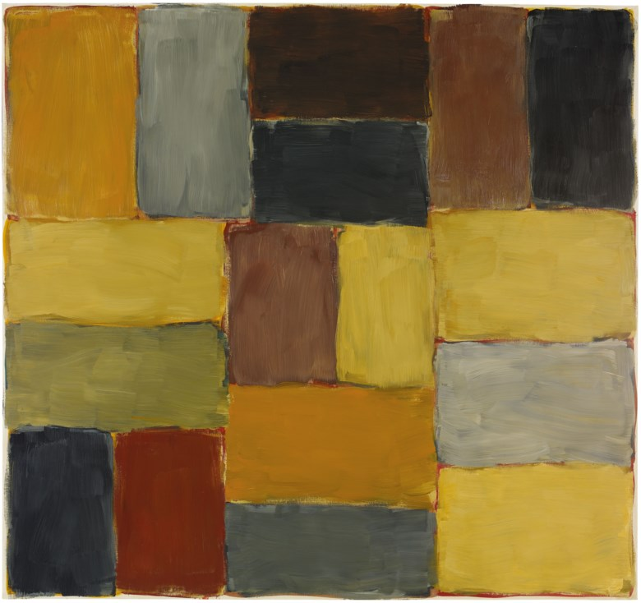
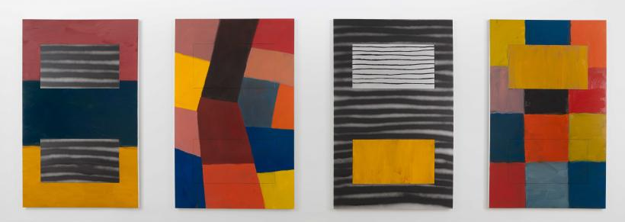
Sean Scully

Slide 3
Sean Scully
Today we are looking at the work of Sean Scully, an American artist working as a painter, printmaker, sculptor and photographer.
He uses stripes and blocks of colour.
He mixes colours and paints thick and thin, long and short lines and blocks of colour.
Sean Scully is an abstract artist which means his work doesn’t represent real objects but involves lines, shapes and colours.

Slide 4
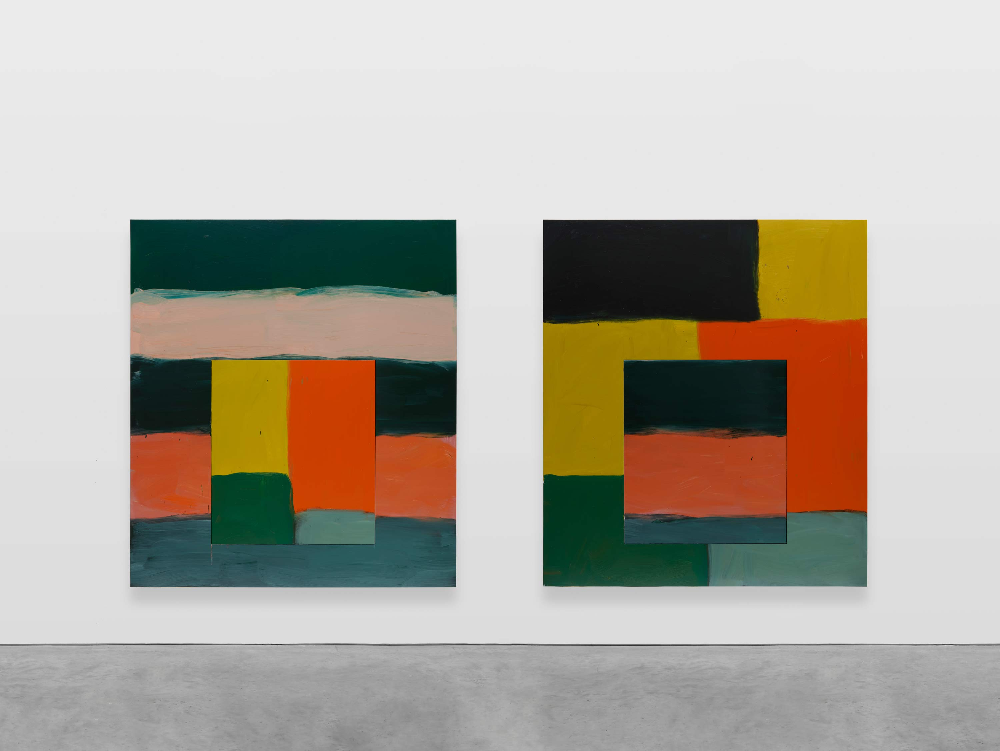
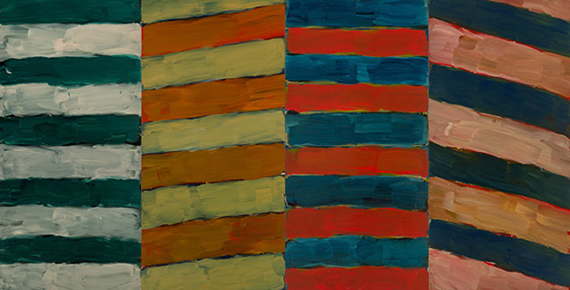
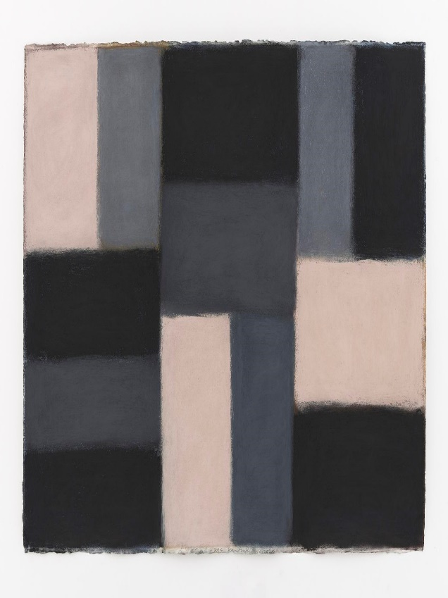
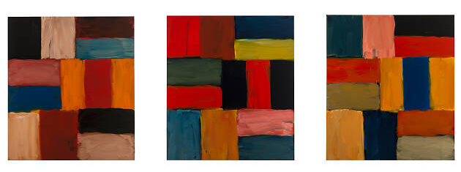
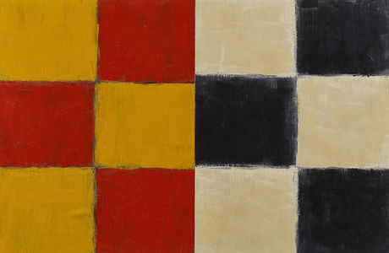
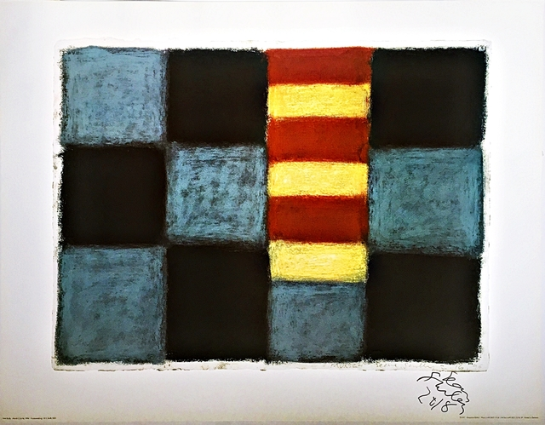

Slide 5
Your task:
I want you to look at the different styles and techniques used in the pictures in the last slide and use your imagination and whatever media you would like from Purple mash to paint a picture and create your own piece of work in the style of Sean Scully.
I look forward to seeing your creations. Save them and send them to me please.

