Slide 1

Maths
04/03/2021

Slide 2
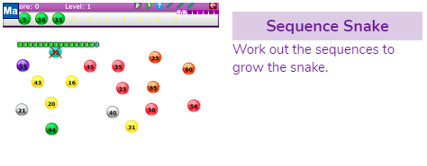
Morning Starter
You will find this in your 2Dos on Purple Mash
Remember to always add the same number to make the pattern
What operation do you need to use?
Remember to work out the pattern of the numbers/ the sequence.

Slide 3
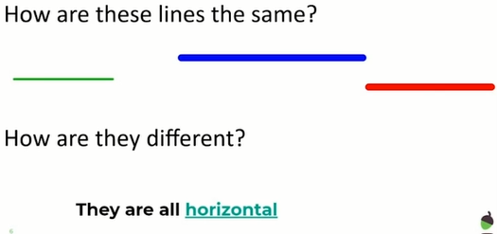
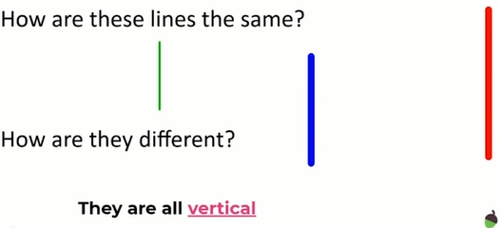
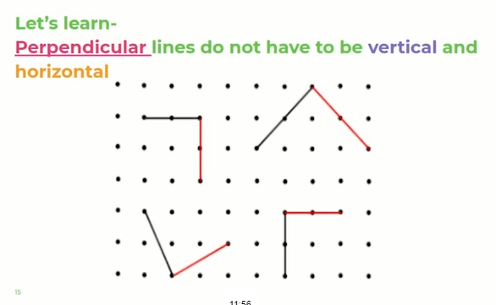
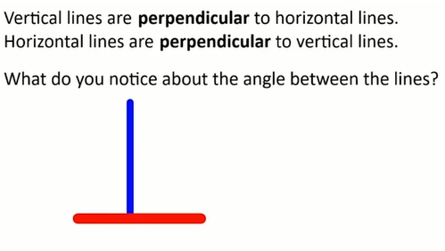
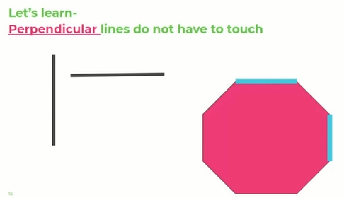
Hi everyone, just a quick recap on yesterday’s learning to begin with.

Slide 4

Todays Learning
I’d like you to watch the Oak Academy maths lesson - Shapes and angles –Can I identify and explain parallel lines?
https://classroom.thenational.academy/lessons/to-identify-and-explain-parallel-lines-cdh3ct?step=2&activity=video

Slide 5
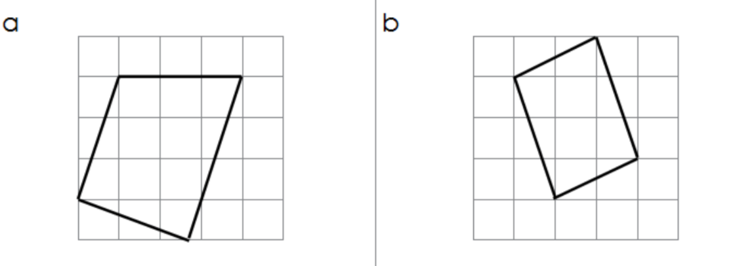
Thursday 04.03.21
LO: Can I identify horizontal and vertical pairs parallel lines?
Which of these lines are parallel?
Spot the parallel lines in these shapes

Slide 6
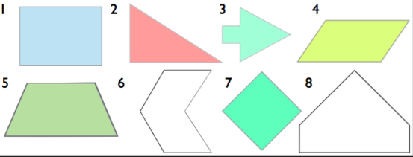
Spot the parallel lines in these shapes
True or false?
“Any pair of straight lines is called parallel”

Slide 7
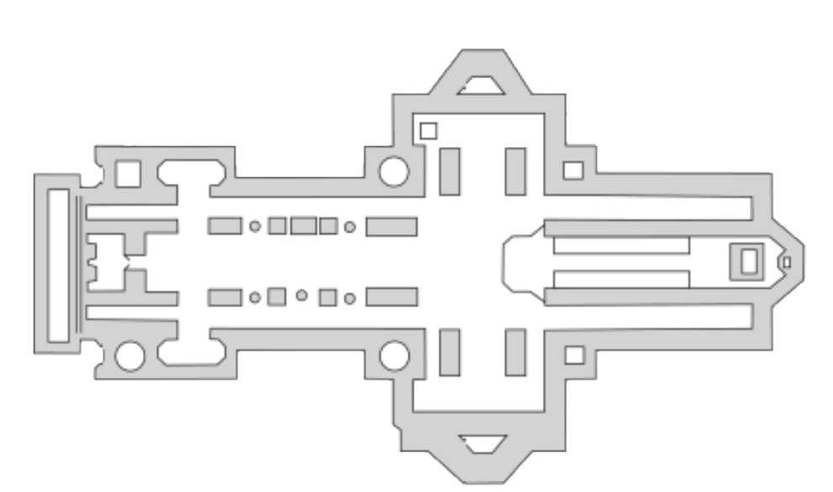
Challenge -
Can you spot all of the parallel lines in this picture?

Slide 8
Click on PurpleMash and follow your 2Do’s.
Don’t forget to save it and send it to me.

