Slide 1

PSHE
22.02.21

Slide 2
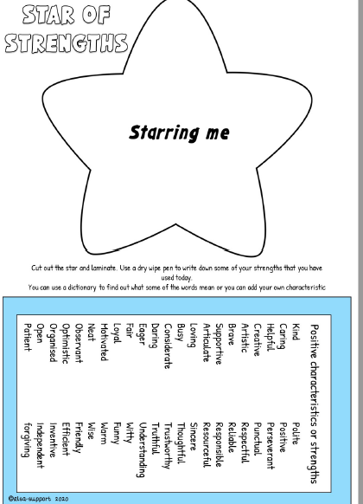

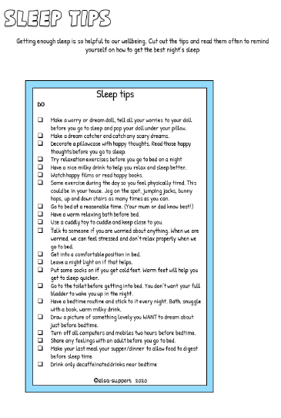
Wellbeing
We are continuing our
Wellbeing toolkit.
Keeping positive
thoughts write down
your strengths and
check your getting
enough sleep.

Slide 3
Watch this youtube video on meditation
https://www.youtube.com/watch?v=DWOHcGF1Tmc
Your task is set as a 2Do in purple mash pages 11 and 12
Then I would like you to do one of the tasks from the grid below about Fair trade fortnight, remember to send me any work you do.

Slide 4
Fair trade fortnight
Tell a family member or friend about Fairtrade and the difference it makes to
people and the planet.

