Slide 1

Spanish
01.03.21

Slide 2

What to do:
-
As always are lessons are song based so today we are going to start with Supermovers and our greetings. https://www.bbc.co.uk/teach/supermovers/ks1--ks2-mfl-spanish-greetings-with-ben-shires/zfksqp3
This weeks lesson is counting to 0-11
Watch these videos then have a go at the worksheets below. https://www.youtube.com/watch?v=T5ocspE4Kuc&feature=youtu.be

Slide 3
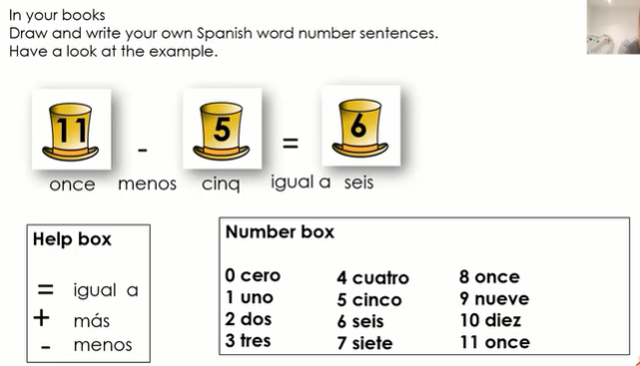
Monday 01.03.21
LO: I can remember to say and write numbers in Spanish from 0 – 11?

