Slide 1
Wednesday 10-02-21

Slide 2
Watch the lesson Find the Total; and then work on the questions on the sheet. If you get stuck play the clip again.
You will need to remember your addition skills – get those secret weapons out!!!
https://whiterosemaths.com/homelearning/year-2/week-11-measurement-money/

Slide 3
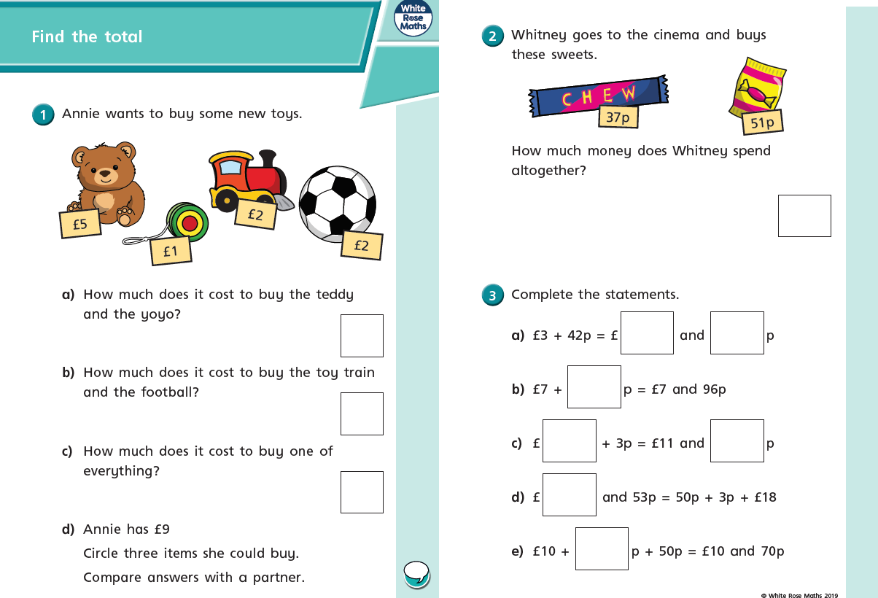

Slide 4
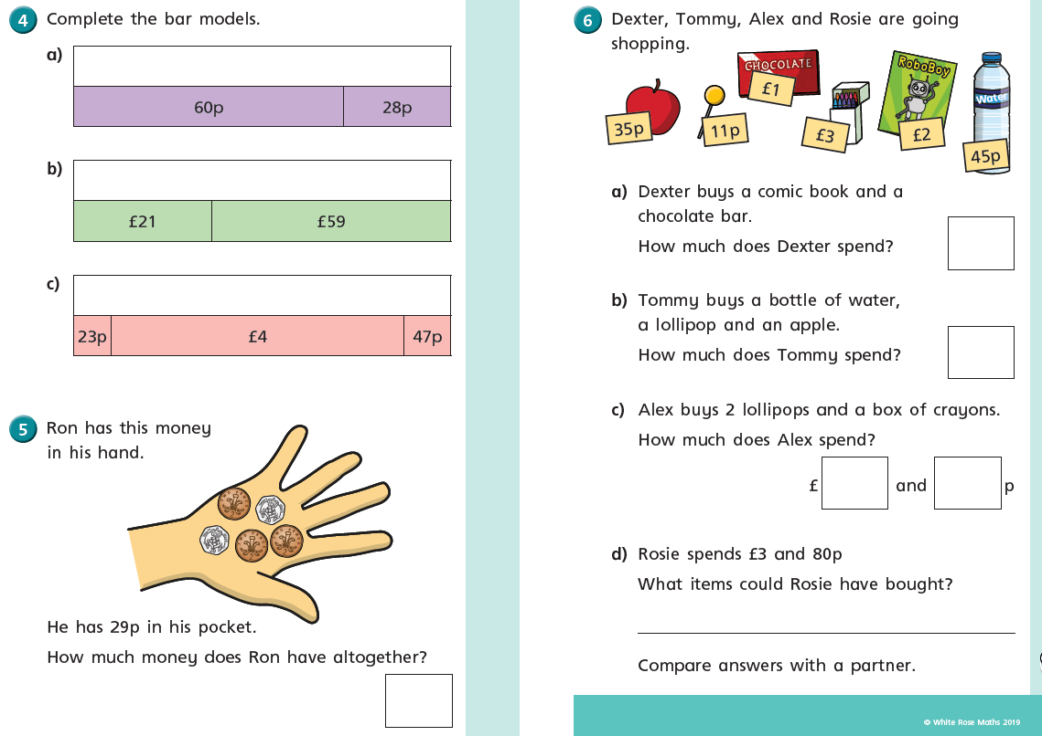

Slide 6
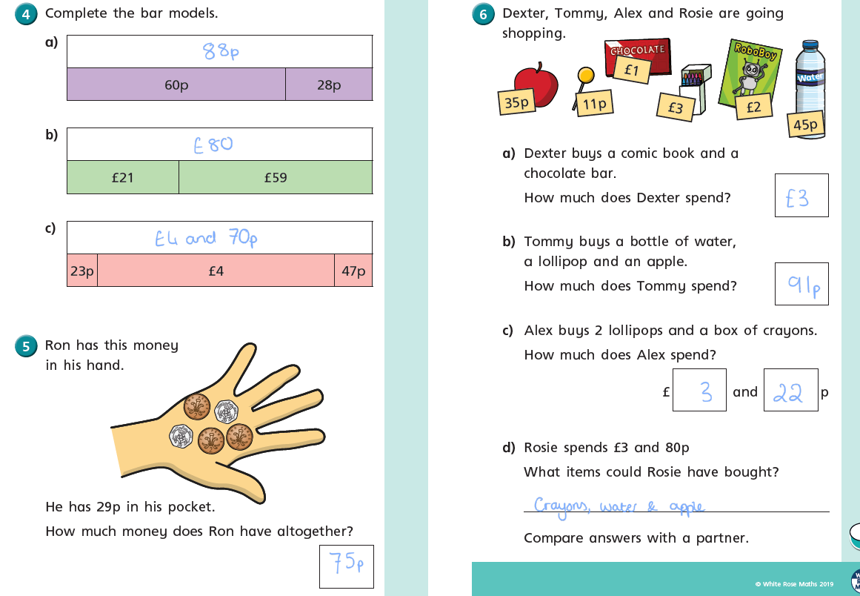

Slide 7
How to write on a PDF
Open PDF in Purple Mash
Click on TOOLS tab
Select COMMENT
Select from tool bar
Click where you need to write answer then type in box

Slide 8
The work sheets are on the School page as usual; but I have uploaded them onto purple mash as PDF file that if you follow the instructions you can write on.
Let’s have a go at using the editing tools on Purple mash. Look at the instructions on the next slide; and then go on the website and use the worksheet for today. You may need and adult to help you.
Top Tip write the instructions down so you don’t have to keep looking at the slide.
https://www.purplemash.com/sch/worth-bd22

