Slide 1

English
04/03/2021

Slide 2

Handwriting
Practice your letter families.
https://www.letterjoin.co.uk/tablet_login/
LETTERJOIN – Students – Password lj8943 shape L or home

Slide 3
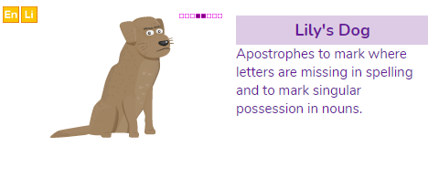
Grammar
Todays task is Lilly’s dog on Purple mash.
https://www.purplemash.com/#tab/pm-home

Slide 4
Spelling
https://www.purplemash.com/#tab/pm-home
Your spellings this week are on PurpleMash. Click on your alerts to find all the work set

Slide 5






Mixed up fairy tales

Slide 6

Todays task is in your 2Do’s on purple mash
LO: Can I write a narrative with a clear structure, setting, characters and plot?
Can I understand the use of inverted commas?
Today I want you to plan your own version of the story and write the end of your story Think about:
Resolution
Write about how the problem will be fixed. Think about how the characters might work together to solve whatever has gone wrong.
Closing
Bring everything in the story to an end and make sure the problem has been fixed.

Slide 7
Reading - Comprehension
Today’s comprehension is a RIC video – Rio 2 Trailer 2 - watch this video and talk through the answers to the questions.
Duck Slip/Slap/Slop sun safe video 2009 | https://www.youtube.com/watch?v=YzYHwzSE1VY | R) What do the 5 S words instruct people to do? I) Who do you think this advert is aimed at? Why? C) What have the makers done to make it successful?

