Slide 1
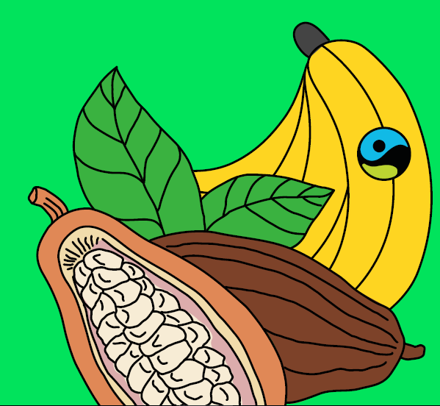
Wednesday 3rd March 2021
Geography Fairtrade Fortnight
(22nd February-7th march 2021)

Slide 2
Today we are learning: That cocoa is grown in hot countries. That Fairtrade chocolate can make a difference to a cocoa farmer’s life. I will learn how chocolate is made.

Slide 4
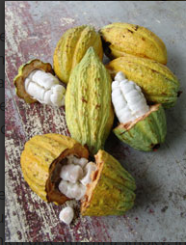
Can you click the link and watch the video to find out about how Cocoa is grown and harvested.
https://vimeo.com/3385105

Slide 5
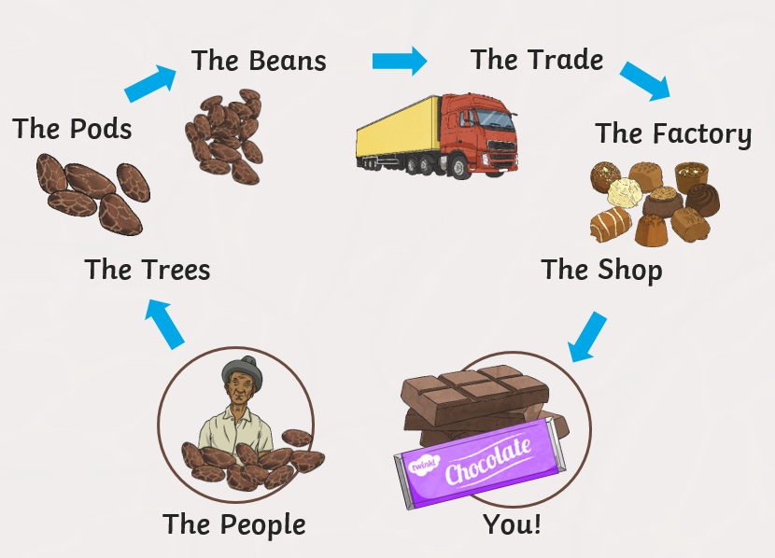

Slide 9
Can you tell the story of the chocolate to someone else? Where does it begin? How does it get to us?
What is Fairtrade?
Why is Fairtrade important?
Remember to send any pictures of any of your work to me at s.hiley@worthvalleyprimary.co.uk

