Slide 1
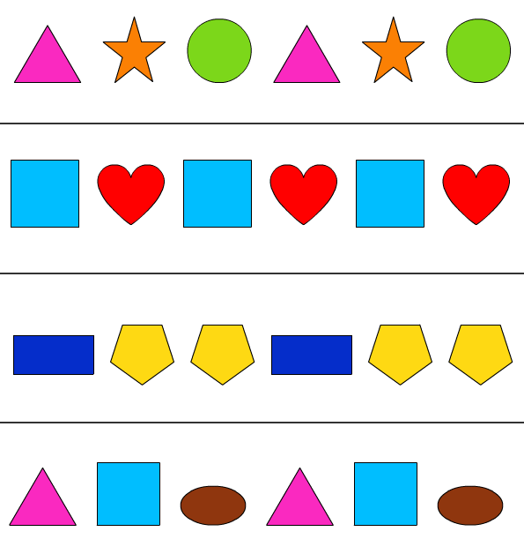
Wednesday 03-03-21
This week we are looking at patterns; how to make them
and how to describe them. How to use language to say where a
shape is in an arrangement
https://classroom.thenational.academy/lessons/to-recognise-and-describe-repeating-patterns-6hjk4c
Now try to make your own repeating patterns/ tile patterns or try the pattern quizzes; have fun!
https://www.coolmath4kids.com/manipulatives/pattern-blocks

